Slide 1
Development and Validation of the US Older Adults Oral Health Microsimulation Model
Zhixin Cao, Yuhao Wang

Slide 2
Introduction

Slide 3
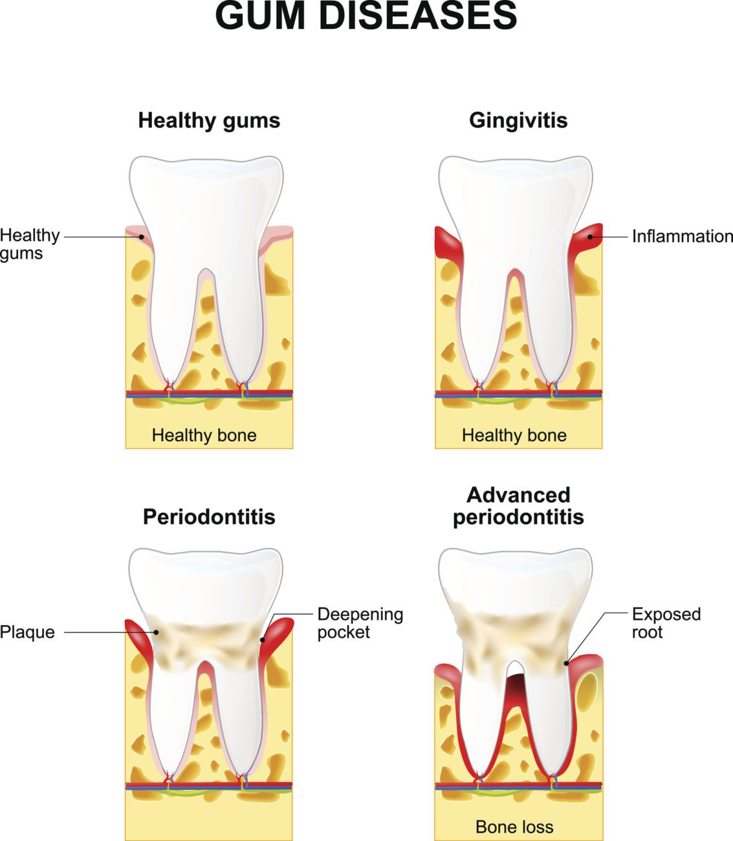
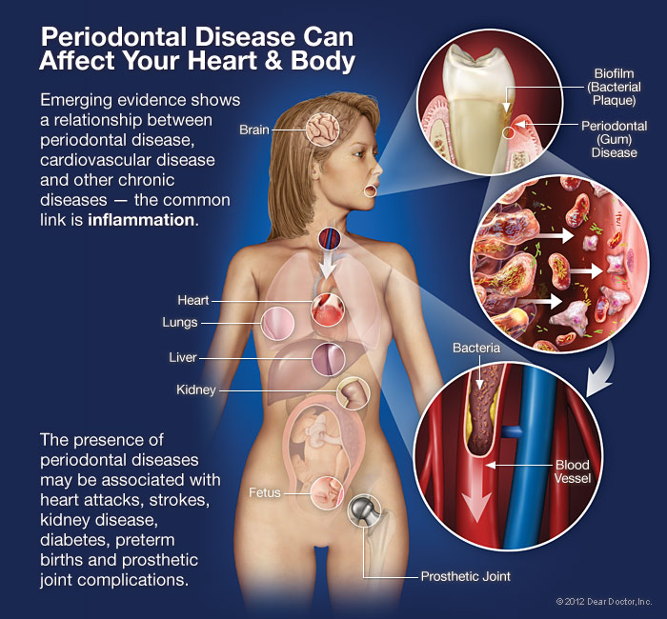
The Public Health Burden of Periodontal Disease and Tooth Loss in the U.S.
Nearly 42% of U.S. adults aged 30+ have periodontitis; 7.8% have severe forms (Eke et al., 2018).
1 in 5 older adults (65+) suffer complete tooth loss (edentulism) (Dye et al., 2012).
Periodontal disease progresses slowly but leads to irreversible tissue destruction and tooth loss (Genco & Sanz, 2020).
gingivitis → mild periodontitis → severe periodontitis → tooth loss
Tooth loss and severe periodontal disease affect beyond oral health as they are associated with:
Depression and Social Isolation (Nazir, 2017)
Comorbidities: T2D, CVD, and etc. (Winning & Linden, 2015)
Increased Mortality Risk (Romandini et al., 2021)
Reduced intake of FV & Proteins, increasing risk for malnutrition and chronic disease (Chen et al., 2024).
Notes:
[1] Genco, R. J., & Sanz, M. (2020). Clinical and public health implications of periodontal and systemic diseases: An overview. Periodontology 2000, 84(1), 7–13.
[2] Nazir, M. A. (2017). Prevalence of periodontal disease, its association with systemic diseases and prevention. International Journal of Health Sciences, 11(2), 72–80.
[3] Winning, L., & Linden, G. J. (2015). Periodontitis and systemic disease: association or causality? Bdj Team, 219(5), 251–255.
[4] Romandini, M., Antonoglou, G., Baima, G., et al. (2021). Periodontitis, edentulism, and risk of mortality: a systematic review with meta-analyses. Journal of Dental Research, 100(1), 37–49.
[5] Eke, P. I., Thornton-Evans, G. O., Wei, L., Borgnakke, W. S., Dye, B. A., & Genco, R. J. (2018). Periodontitis in U.S. adults: Prevalence, severity, and trends. Journal of Periodontology, 89(5), 556–565. https://doi.org/10.1002/JPER.17-0350
[6] Dye, B. A., Tan, S., Smith, V., Lewis, B. G., Barker, L. K., Thornton-Evans, G., ... & Li, C. H. (2012). Selected oral health indicators in the United States, 2005–2008. NCHS Data Brief, (96), 1–8.

Slide 4
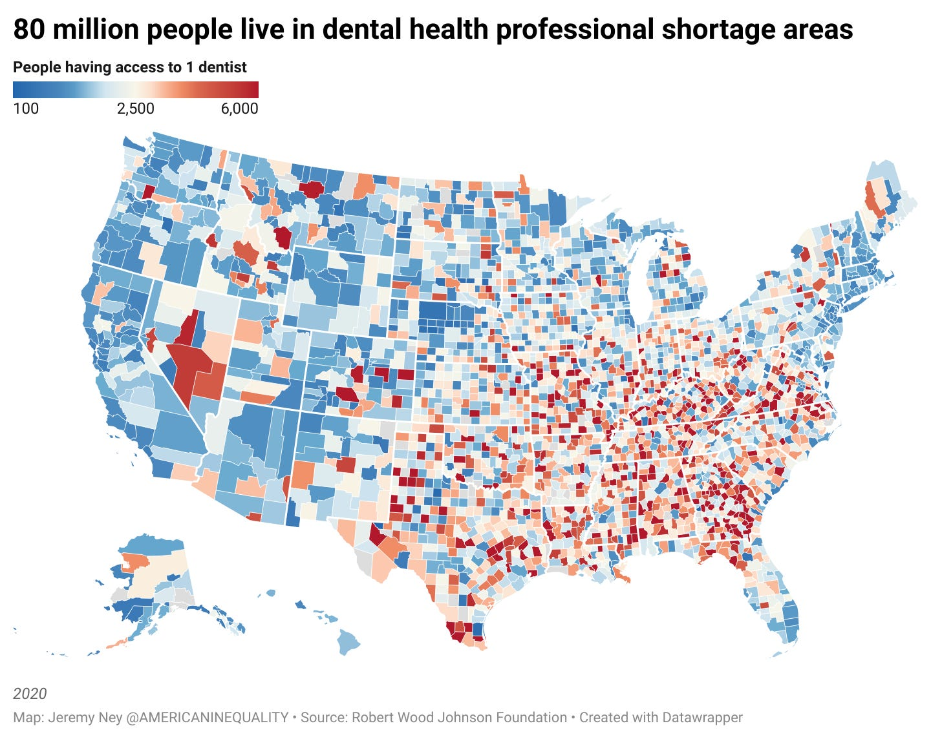
Socioeconomic Burden of Periodontal Disease and Tooth Loss in the U.S.
Disproportionate Burden Driven by Structural Inequities
Low-income, racial/ethnic minorities, and uninsured adults are disproportionately affected (CDC, 2019).
Black and Hispanic populations are 1.5–2× more likely to experience severe periodontitis (Hashim et al., 2025).
Social determinants of health—like limited access to preventive care and poor oral health literacy—increase disparities.
Medicaid adult dental benefits are optional in most states, resulting in gaps in coverage and care (Yarbrough et al., 2016).
Fiscal and Economic Impact
U.S. annual dental spending exceeded $155 billion in 2022 (ADA-HPI, 2022).
Periodontal treatment and prosthetic tooth replacement are major cost drivers (Guay, 2012).

Slide 5
Modeling Oral Health: Microsimulation for Periodontal Disease and Tooth Loss in the U.S.
Cross-Sectional Population Surveys
Longitudinal Cohort Studies
How Microsimulation Models Address Limitations in PD & TL Research
Used to estimate prevalence and demographic distribution of PD and TL.
Limitations: It does not capture disease progression or evaluate intervention impacts.
(Qu et al., 2019; CDC, 2019)
Follow individuals over time to assess the natural progression of disease, risk factors, and outcomes such as tooth loss – VA Dental Longitudinal Study
Limitations: costly, and less adaptable to assessing various policy scenarios.
(Romandini et al., 2021; Genco & Sanz, 2020)
Captures Individual-Level Heterogeneity: Individual-level models simulate hypothetical cohorts with diverse attributes (e.g., age, race, income, comorbidities, insurance status)
(Choi, Sima, & Pandya, 2020; Broomhead et al., 2023)
Simulates Long-Term Disease Progression
Tracks periodontal status, tooth retention, and intervention outcomes over decades, something not feasible in real-world trials.
Replaces static transitions (in Markov models) with dynamic life-course modeling.
(Qu et al., 2019)
Policy & Intervention Scenarios
Helps evaluate cost-effectiveness for public health programs.
(Choi et al., 2020; Brocklehurst et al., 2019)
Markov and Decision Tree Models
Regression-Based Analyses
discrete-state transition (e.g., healthy → gingivitis → periodontitis → tooth loss).
The models rely on average transition probabilities and assume homogeneity.
They are static and cannot perform individual-level analysis.
(Qu et al., 2019; Krauth et al., 2019)
Widely applied to explore associations between PD/TL and other factors (e.g., diabetes, SSBs, smoking).
Useful for risk factor identification but limited in predictive or policy-testing power.
These models typically lack temporal dynamics.
(Nazir, 2017; Winning & Linden, 2015)
Notes:
[1] Centers for Disease Control and Prevention. (2019). Oral health surveillance report, 2019. Atlanta, GA: U.S. Dept. of Health & Human Services.
[2] Genco, R. J., & Sanz, M. (2020). Clinical and public health implications of periodontal and systemic diseases: An overview. Periodontology 2000, 84(1), 7–13. https://doi.org/10.1111/prd.12344
[3] Krauth, C., Qu, Z., Zhang, S., & Liu, X. (2019). A systematic review of decision analytic modeling techniques for the economic evaluation of dental caries interventions. PLOS ONE, 14(5), e0216921. https://doi.org/10.1371/journal.pone.0216921
[4] Nazir, M. A. (2017). Prevalence of periodontal disease, its association with systemic diseases and prevention. International Journal of Health Sciences, 11(2), 72–80. https://www.ncbi.nlm.nih.gov/pmc/articles/PMC5426403/
[5] Qu, Z., Zhang, S., & Krauth, C. (2019). A systematic review of decision analytic modeling techniques for the economic evaluation of dental caries interventions. PLOS ONE, 14(5), e0216921.
[6] Romandini, M., Baima, G., Antonoglou, G., et al. (2021). Periodontitis, edentulism, and risk of mortality: A systematic review and meta-analyses. Journal of Dental Research, 100(1), 37–49. https://doi.org/10.1177/0022034520952401
[7] Winning, L., & Linden, G. J. (2015). Periodontitis and systemic disease: Association or causality? Bdj Team, 219(5), 251–255. https://www.researchgate.net/publication/284812476

Slide 6
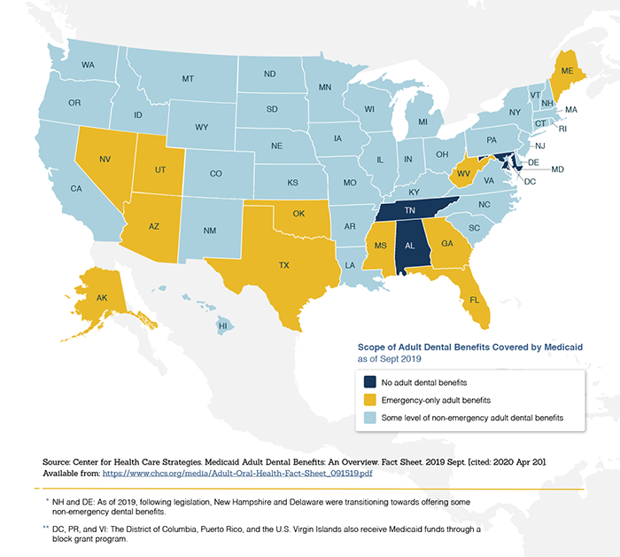
Why Microsimulation is useful in the U.S. Context
U.S. Oral Health System
Unlike most high-income countries with universal dental coverage, the U.S. offers a patchwork system where adult dental benefits under Medicaid are optional and vary by state.
Microsimulation allows effective evaluation of state-level policy scenarios, modeling diverse Medicaid expansions and assessing their cost-effectiveness.
Significant Health Inequities
Significant racial, ethnic, and income-based oral health disparities exist in the U.S., disproportionately affecting Black and Hispanic adults.
Microsimulation is able to capture individual demographic, behavioral, and clinical characteristics, enabling precise modeling for equity-focused policy interventions.
Graphic: Map of Scope of Adult Dental Benefits Covered by Medicaid as of Sept. 2019
Notes:
[1] Yarbrough, C., Vujicic, M., & Nasseh, K. (2016). Medicaid adult dental benefits: An overview. ADA Health Policy Institute.
[2] Hashim, N. T., Babiker, R., & Padmanabhan, V. (2025). IJERPH, 22(4), 624.
[3] https://odphp.health.gov/our-work/national-health-initiatives/healthy-people/healthy-people-2020/healthy-people-2020-law-and-health-policy/oral-health

Slide 7
Why Microsimulation is useful in the U.S. Context
Fragmentation and Lack of Longitudinal Data
The U.S. has extensive oral health datasets; however, most sources are cross-sectional, not longitudinal, and often lack clear linkage between clinical measures and policy-relevant outcomes (Metcalf et al., 2011; Choi, Sima, & Pandya, 2020).
NHANES Data Constraints
Although NHANES provides high-quality clinical oral health data, it is cross-sectional, and periodontal data collection ceased after the 2013–2014 cycle (CDC, 2019).
Historical longitudinal oral health data is limited. Only the NHANES I (1971–1975) included a follow-up component (NHEFS), but recent cycles lack similar follow-ups (NCHS, 1992).
Access-Restricted Administrative Data
CMS Medicare/Medicaid claims, MEPS, and EHRs provide valuable utilization and cost data, but each covers different populations, with limited linkage and access. (Qu, Zhang, & Krauth, 2019)
Microsimulation address these gaps:
Allows researchers to synthesize fragmented datasets, model longitudinal disease progression, and evaluate multi-level interventions (e.g., coverage expansion, preventive programs).
(Broomhead, Ballas, & Baker, 2023; Choi et al., 2020)
Notes:
[1] Broomhead, T., Ballas, D., & Baker, S. (2023). Using spatial microsimulation to understand tooth decay and oral policy effects. Regional Science Policy & Practice. https://doi.org/10.1111/rsp3.12567
[2] Centers for Disease Control and Prevention. (2019). Oral health surveillance report, 2019. Atlanta, GA: U.S. Dept. of Health & Human Services.
[3] Choi, S. E., Sima, C., & Pandya, A. (2020). Cost-effectiveness of periodontal treatment in patients with type 2 diabetes. Diabetes Care, 43(3), 563–571. https://doi.org/10.2337/dc19-1292
[4] Metcalf, S. S., Widener, M. J., & Northridge, M. E. (2011). Modeling the dynamics of dental health in older adults. APHA Conference. https://apha.confex.com/apha/140am/webprogram/Handout/Paper272525
[5] National Center for Health Statistics (NCHS). (1992). NHANES I Epidemiologic Follow-up Study (NHEFS), 1992 Public Use Data Release.
[6] Qu, Z., Zhang, S., & Krauth, C. (2019). A systematic review of decision analytic modeling techniques for the economic evaluation of dental caries interventions. PLOS ONE, 14(5), e0216921. https://doi.org/10.1371/journal.pone.0216921

Slide 8
Literature Review

Slide 9
Oral Health Microsimulation Models: Current Development, Gaps, and the DOC-M Integration
Introduction
Microsimulation models are widely used to simulate chronic disease trajectories, particularly in diabetes, obesity, and cardiovascular disease (CVD).
However, oral health conditions — especially periodontal disease and tooth loss — remain largely excluded, despite their significant impact on overall health, diet, and equity.
Key Components in Oral Health Microsimulation Models
Periodontal Disease Progression
Tooth Loss Progression
Health Behaviours & Lifestyle Risks
Socioeconomic Factors
Chronic Disease

Slide 10
Limitations in Periodontal Disease Microsimulation Modeling
Lack of Stage-Based Disease Progression
Most models simplify periodontal disease as binary states (presence/absence), omitting detailed clinical stages (e.g., None/Mild, moderate periodontitis, severe periodontitis).
Existing stage-based models (Elamin & Ansah, 2023; Kassebaum et al., 2017) lack individual-level dynamics and behavioral feedback.
Limited Dynamic Risk Factor Integration
Behavioral risk factors (smoking, diet quality, oral hygiene) typically static, not evolving over time.
Healthy Eating Index (HEI)—an important dietary quality indicator—is rarely modeled dynamically despite strong evidence of its influence on periodontal inflammation (Zhao et al., 2025; Tonmukayakul et al., 2015).
Unidirectional Disease-System Interactions: Most simulations focus only on periodontal impact on systemic diseases (e.g., diabetes), neglecting reciprocal feedback from systemic diseases back to periodontal health.
Notes:
References
Choi, S. E., Sima, C., & Pandya, A. (2020). Impact of treating oral disease on preventing vascular diseases: A model-based cost-effectiveness analysis of periodontal treatment among patients with diabetes. Diabetes Care, 43(3), 563–571. https://doi.org/10.2337/dc19-1201
Elamin, A., & Ansah, J. P. (2023). Modeling the long-term burden of oral disease in the UK using a system dynamics approach. Journal of Public Health Dentistry, 83(1), 60–69. https://doi.org/10.1111/jphd.12544
Homer, J., & Hirsch, G. B. (2020). System dynamics modeling for public health: Background and opportunities. American Journal of Public Health, 96(3), 452–458. https://doi.org/10.2105/AJPH.2005.062059
Kalaterahman, M. Y. (2019). Modeling diabetes-related complications in Canada using patient-level microsimulation [Doctoral dissertation, University of Saskatchewan]. University of Saskatchewan Electronic Theses and Dissertations. https://harvest.usask.ca/handle/10388/12423
Kassebaum, N. J., Bernabé, E., Dahiya, M., Bhandari, B., Murray, C. J. L., & Marcenes, W. (2017). Global burden of severe periodontitis in 1990–2010: A systematic review and meta-regression. Journal of Dental Research, 93(11), 1045–1053. https://doi.org/10.1177/0022034514552491
Tonmukayakul, U., Calache, H., Clark, R., Wasiak, J., & Faggion, C. M. (2015). Systematic review and quality appraisal of economic evaluation publications in dentistry. Journal of Dental Research, 94(10), 1348–1354. https://doi.org/10.1177/0022034515602920
Zhao, F., Heffernan, M., Chaudhry, S., & Conrad, D. A. (2025). Healthy eating index and periodontal health: Evidence from longitudinal cohort data. MDM Policy & Practice. (In Press).

Slide 11
Addressing the Limitations in Periodontal Disease Microsimulation Modeling
Detailed, Dynamic Clinical Progression: Models periodontal health stages dynamically (Healthy → None/Mild → Moderate → Severe)
Behavior-Responsive Risk Modeling: Dynamically integrates modifiable factors (HEI, food intake pattern) to reflect real-life scenarios.
Bidirectional Systemic Disease Integration: Captures reciprocal feedback between periodontal and chronic conditions (e.g., diabetes, cardiovascular disease) via integration with the DOC-M framework.
Study | Country | Periodontal Stages Modeled | Limitation
Choi et al. (2020) | USA | No (binary treated/untreated) | Lacks progression modeling; does not include stage-specific risk transitions or behavioral feedback.
Elamin & Ansah (2023) | UK | Yes (multi-stage, projected prevalence) | System-level only; lacks individual behavior, feedback mechanisms, and time-varying risks.
Kassebaum et al. (2017) | Global (GBD Study) | Yes (GBD categories, severity-based) | Descriptive global modeling; does not support dynamic or intervention testing at the person-level.
Tonmukayakul et al. (2015) | Australia | Yes (early stages in prevention vs treatment) | Focuses on children; lacks adult progression, systemic feedback, or HEI integration.
Kalaterahman (2019) | Canada | No (oral health proxy only) | No periodontal structure; uses oral outcomes as an input without modeling transitions.

Slide 12
Oral Health Microsimulation Models: Current Development, Gaps, and the DOC-M Integration
Key Components in Oral Health Microsimulation Models
Periodontal Disease Progression
Tooth Loss Progression
Health Behaviours & Lifestyle Risks
Socioeconomic Factors
Chronic Disease

Slide 13
Limitations in Tooth Loss Progression Modeling
Limitation | Our Approach
Lack of Longitudinal, Person-Level Simulation Most tooth loss analysis are cross-sectional or descriptive in nature. | Microsimulation Modelling
Limited Use of Count-Based Models for Tooth Loss & Over-reliance on Binary Tooth Presence/Absence Some studies (e.g., Maitra, 2012) explore Poisson models for spatial clustering of diseased teeth but do not generalize to full-mouth simulation or national representativeness using NHANES. Studies such as Wu et al. (2021) and Hill et al. (2023) employ modified Poisson regressions for tooth loss risk factors but treat the outcome as binary (tooth present vs. absent) or categorical, rather than as a count variable of teeth lost. | Use of Poisson Regression for Count-Based Tooth Loss The expected number of teeth present (0–28) per individual was predicted using a Poisson regression model, enabling simulation of partial retention and trajectory-based modeling, reflecting realism and supporting lifetime planning scenarios.
Lack of Integration with Periodontal and Systemic Health Models Tooth loss is often modeled in isolation from its biological drivers (e.g., periodontitis) and systemic outcomes (e.g., nutrition, cardiovascular function). This creates fragmented evidence and prevents simulation of integrated policies such as dual medical-dental interventions. | Integration with Periodontal Disease Staging Progression Modeling The model treats tooth loss not just as a final outcome but as a dependent process influenced by progression through PD stages (e.g., severe periodontitis → tooth loss).

Slide 14
Oral Health Microsimulation Models: Current Development, Gaps, and the DOC-M Integration
Key Components in Oral Health Microsimulation Models
Periodontal Disease Progression
Tooth Loss Progression
Health Behaviours & Lifestyle Risks
Demographic & Socioeconomic Factors
Chronic Disease

Slide 15
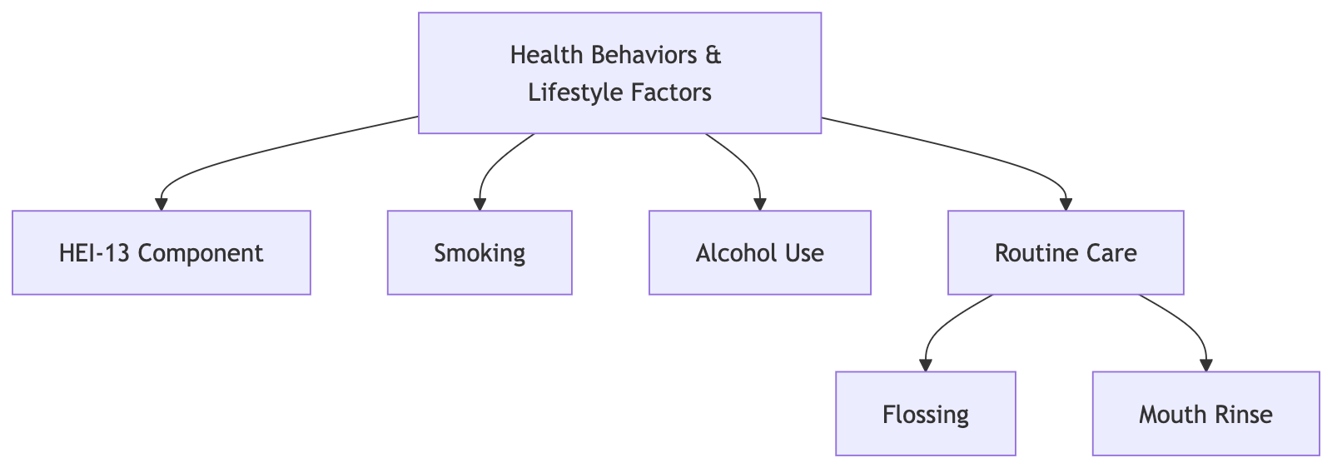
Directional and Bidirectional Associations Between Lifestyle Factors and Periodontal Disease and Tooth Loss

Slide 16
Healthy Eating Index (HEI) and Oral Health Outcomes
HEI is frequently associated with periodontal disease and tooth loss in both cross-sectional and longitudinal studies.
Lower HEI scores correlate with:
↑ Prevalence of periodontitis (Li et al., 2022; Hao et al., 2023; Bitencourt et al., 2023)
↑ Risk of tooth loss and edentulism (Zhu & Song, 2023; Gorman, 2011)
↓ Chewing efficiency, nutrient intake, and ↑ systemic inflammatory response (Kotróniá et al., 2021; Marruganti et al., 2025)
Limitation | Our Approach
HEI treated as static value | HEI was modelled as a dynamic, time-varying exposure influenced by age & chewing ability.
No feedback loops from tooth loss to HEI where: Lower HEI → higher inflammation → worsened periodontal disease → tooth loss → impaired eating → further HEI reduction. | Our model includes bidirectional interaction, where tooth loss (e.g., molar absence) reduces food intake quality, impacting HEI and inflammation.
HEI is rarely linked to simulation or progression models | HEI is embedded within DOC-M simulation, affecting diabetes, obesity, and cardiovascular progression via systemic inflammation.
Notes:
References
Li, X. et al. (2022). The association of healthy eating index with periodontitis in NHANES 2011–2012. Front Nutr. Link
Bitencourt, F.V. et al. (2023). The role of dyslipidemia in periodontitis: sensitivity analysis including HEI. Nutrients, 15(2), 300. PDF
Hao, Y. et al. (2023). HEI and insulin resistance mediated by tooth loss. Nutrients, 15(23), 5008. HTML
Zhu, J. & Song, H. (2023). HEI and tooth loss in NHANES 2011–2012. Research Square. PDF
Kotronia, E. et al. (2021). Poor oral health and diet quality in older people in UK/USA. Br J Nutr., 126(3), 431–440. PDF
Marruganti, C. et al. (2025). Healthy lifestyle and periodontal health. J Clin Periodontol. DOI
Gorman, A. E. (2011). Obesity, diet quality, and periodontal disease in men. PhD Dissertation, ProQuest.
Bukhary, D. M. et al. (2023). Diet and teeth rehabilitation in diabetic patients. Cureus. PDF

Slide 17
HEI-13 Components Associations with Periodontal Disease and Tooth Loss
HEI-13 Component | Association with Periodontal Disease (PD) | Association with Tooth Loss (TL)
Total Fruits (TF) （per serving) | TF ↑ → ↓ PD risk by 10%[1, 4] PD ↑ → TF intake ↓ (chewing pain) [2] | TF ↑ → TL risk ↓ [1, 4] TL ↑ → TF intake ↓ (due to chewing difficulty) [2]
Whole Fruits (WF) | WF ↑ → Plaque ↓ → PD ↓ [1, 4] PD ↑ → WF intake ↓ [3] | WF ↑ → Nutrient intake ↑ → TL risk ↓ [2, 4] TL ↑ → WF intake ↓ (firm texture avoidance) [2]
Total Vegetables (TV) | TV ↑ → Antioxidants ↑ → PD ↓ [1, 4] PD ↑ → TV intake ↓ [3] | TV ↑ → Immune support ↑ → TL ↓ [1, 4] TL ↑ → TV intake ↓ (fibrous chewing burden) [2]
Greens & Beans (GB) | GB ↑ → Fiber/polyphenols ↑ → PD ↓ [1, 4] PD ↑ → GB intake ↓ (chewing difficulty) [3] | GB ↑ → Bone/antioxidant support ↑ → TL ↓ [1, 4] TL ↑ → GB intake ↓ [2]
Whole Grains (WG) | WG ↑ → CRP ↓ → PD ↓ [1] PD ↑ → WG intake ↓ (switch to refined) [3] | WG ↑ → Inflammation ↓ → TL ↓ [1, 4] TL ↑ → WG intake ↓ (chewing limitations) [2]
Dairy (D) | D ↑ → Calcium/Vitamin D ↑ → PD ↓ [1, 4] PD ↑ → D intake ↓ (oral soreness) [3] | D ↑ → Bone density ↑ → TL ↓ [1, 4] TL ↑ → D intake ↓ (denture discomfort) [2]
Protein Total (PT) | PT ↑ → Tissue repair ↑ → PD ↓ [1] PD ↛ PT (soft proteins accessible) [3] | PT ↑ → Mucosal health ↑ → TL ↓ [1, 4] TL ↛ PT [2]
Notes:
[1] Lamster, I. B., et al. (2018). Better-quality diet is associated with lower odds of severe periodontitis in US Hispanics/Latinos. Journal of Clinical Periodontology, 45(7), 780–790. https://doi.org/10.1111/jcpe.12926
[2] Fuller, D. L., et al. (2013). Sociodemographic and health-related risk factors associated with tooth loss among adults in Rhode Island. Preventing Chronic Disease, 10, E45. https://doi.org/10.5888/pcd10.110285
[3] Jimenez, J., et al. (2025). Association of dietary intake of theobromine with periodontitis: NHANES 2009–2014. BMC Oral Health, 25(1), 403. https://doi.org/10.1186/s12903-025-05453-0
[4] Chu, C. H., et al. (2023). Diet, Nutrition, and Oral Health in Older Adults: A Review of the Literature. Dentistry Journal, 11(9), Article 222. https://doi.org/10.3390/dj11090222

Slide 18
HEI-13 Components Associations with Periodontal Disease and Tooth Loss
HEI-13 Component | Association with Periodontal Disease (PD) | Association with Tooth Loss (TL)
Seafood/Plant Protein (SP) | SP ↑ → Omega-3 ↑ → Inflammation ↓ → PD ↓ [1, 4] PD ↛ SP [3] | SP ↑ → Systemic inflammation ↓ → TL ↓ [1] TL ↛ SP [2]
Fatty Acid Ratio (FAR) | FAR ↑ → Inflammation ↓ → PD ↓ [1] PD ↛ FAR [3] | FAR ↑ → CRP ↓ → TL ↓ [1] TL ↛ FAR [3]
Refined Grains (RG) | RG ↑ → Glycemic Load ↑ → PD ↑ [1, 4] PD ↑ → RG intake ↑ (comfort carbs) [3] | RG ↑ → Inflammation ↑ → TL ↑ [1, 4] TL ↑ → RG intake ↑ (easy to chew) [2]
Sodium (Na) | Na ↑ → Gingival edema/inflammation ↑ → PD ↑ [1] PD ↛ Na directly, but ↑ processed food = ↑ Na [3] | Na ↑ → Soft processed food ↑ → TL ↑ [1, 2] TL ↑ → Na ↑ (due to food texture substitution) [2]
Added Sugars (AS) | AS ↑ → Biofilm ↑ → PD ↑ [1, 4] PD ↑ → AS intake ↑ (comfort eating) [3] | AS ↑ → Caries/periodontal loss ↑ → TL ↑ [2] TL ↑ → AS ↑ (desserts, drinks) [3]
Saturated Fats (SF) | SF ↑ → Inflammatory markers ↑ → PD ↑ [1] PD ↛ SF intake [3] | SF ↑ → Inflammatory burden ↑ → TL ↑ [1] TL ↑ → SF ↑ (comfort food preference) [3]
Notes:
CDC. (2019). Sugar-sweetened beverage consumption among U.S. adults: NHANES 2011–2014. Centers for Disease Control and Prevention. Retrieved from https://stacks.cdc.gov/view/cdc/61824
Ervin, R. B., & Dye, B. A. (2009). Number of natural and prosthetic teeth impact nutrient intakes of older adults in the United States. Gerodontology, 29(2), e693–e702. https://doi.org/10.1111/j.1741-2358.2011.00550.x
Kaye, E. K., Valencia, A., Baba, N., Spiro, A., & Dietrich, T. (2023). Tooth loss and diet quality among older men: The Veterans Affairs Dental Longitudinal Study. Journal of the American Dental Association, 151(8), 595–603.
Kotsakis, G. A., Thai, A., Ioannou, A. L., & Demmer, R. T. (2018). Association between low diet quality and periodontal diseases: NHANES 2009–2012. Journal of Clinical Periodontology, 45(9), 1136–1146.
Li, X.-Y., Wen, M.-Z., Xu, Y.-H., Shen, Y.-C., & Yang, X.-T. (2022). The association of healthy eating index with periodontitis in NHANES 2013–2014. Frontiers in Nutrition, 9, 968073. https://doi.org/10.3389/fnut.2022.968073
Mohammadi, A., Darbandi, M., Pasdar, Y., Mohebi, M., Kamari, N., Ziaei, N., & Najafi, F. (2023). The Healthy Eating Index and oral health among adults: A cross-sectional study from an Iranian RaNCD cohort data. Scientific Reports, 13, 11706. https://doi.org/10.1038/s41598-023-37168-z
Sanders, A. E., Cardel, M., Laniado, N., Kaste, L. M., Finlayson, T. L., & Perreira, K. M. (2014). Diet quality and dental caries in the United States. Journal of the American Dental Association, 145(10), 1021–1028.
Song, W., Yang, Z., Wang, Y., Zhu, H., & Zhang, X. (2023). Dietary fiber intake and tooth loss: A prospective analysis. Journal of Nutrition, Health & Aging, 27(2), 173–179.
Wiener, R. C., Wiener, M. A., & McNeil, D. W. (2014). Sodium intake and tooth loss: NHANES 2009–2012. Journal of Dental Research, 93(7), 635–641. https://doi.org/10.1177/0022034514531901

Slide 19
Associations Between Lifestyle Factors and Periodontal Disease and Tooth Loss
Factor | Association with Periodontal Disease (PD) | Association with Tooth Loss (TL)
Smoker Status Former Smoker Current Smoker Never Smoker | Current smokers in the U.S. are at significantly greater risk for both periodontal disease and tooth loss compared to never smokers, with risk ratios for periodontitis as high as 1.85 (95% CI: 1.5–2.2). [1] Former smokers show reduced risk, but not to the level of never smokers [2] [3]. | Smoking increases the risk of losing 6 or more teeth by 10.7% (95% CI: 10.0%–11.3%) and the risk of complete tooth loss (edentulism) by 2.6% (95% CI: 2.3%–2.8%) relative to never smokers [4]. Smoking cessation reduces the risk of losing 6 or more teeth by 13.5% and the risk of edentulism by 7.6% compared to current smokers [4].
Alcohol Use Never Drinker Former Drinker Light Drinker Moderate Drinker Heavy Drinker | Heavy drinkers had an adjusted OR of 1.65 (95% CI: 1.14–2.39) for periodontitis compared to never drinkers [5]. Moderate drinkers had an adjusted OR of 1.21 (95% CI: 0.89–1.66) for periodontitis compared to never drinkers [5]. ORs for light drinkers are close to 1 and not statistically significant [5]. ORs for former drinkers between 1.1–1.2, not always statistically significant [5]. | Heavy alcohol use is an independent risk factor for tooth loss, with reported odds ratios generally in the range of 1.4–2.0 compared to never drinkers [6]. Odds ratios for moderate drinker in U.S. studies typically range from 1.2–1.5 compared to never drinkers [6]. Light drinkers may have a slightly elevated risk compared to never drinkers, but U.S. studies often do not find a statistically significant association (OR close to 1) [6]. Former drinkers’ risk is generally intermediate, often slightly higher than never drinkers but lower than current heavy drinkers. ORs are usually 1.1–1.3 [6].
Notes:
[1] Albandar, J. M., & Rams, T. E. (2023). Periodontal disease and smoking: Systematic review. Journal of International Society of Preventive & Community Dentistry, 13(4), 312–320. https://doi.org/10.4103/jispcd.JISPCD_1_23 [PMC10466628]
[2] Hanioka, T., Ojima, M., Tanaka, K., & Matsuo, T. (2011). Causal assessment of smoking and tooth loss: A systematic review of observational studies. BMC Public Health, 11, 221. https://doi.org/10.1186/1471-2458-11-221 [PMC3087682]
[3] Leite, F. R. M., Nascimento, G. G., Scheutz, F., & López, R. (2019). Effect of smoking cessation on tooth loss: A systematic review with meta-analysis. Journal of Dental Research, 98(9), 926–933. https://doi.org/10.1177/0022034519858089 [PMC6852780]
[4] Wang, Y., Wang, X., Zhang, Y., & Li, X. (2024). Causal effect of smoking and cessation on tooth loss. Frontiers in Public Health, 12, 1304567. https://doi.org/10.3389/fpubh.2024.1304567
[5] Tezal, M., Grossi, S. G., Ho, A. W., Genco, R. J. (2004). The effect of alcohol consumption on periodontal disease. Journal of Periodontology, 75(4), 580–587. https://doi.org/10.1902/jop.2004.75.4.580
[6] Park, S., Choi, Y., Lee, S. A., Kim, S., & Lee, J. H. (2023). Systematic review of longitudinal studies on the association between cluster of health-related behaviors and tooth loss among adults. Journal of Public Health Dentistry, 83(4), 392–404. https://doi.org/10.1111/jphd.12597 [PMC11302646]

Slide 20
Associations Between Lifestyle Factors and Periodontal Disease and Tooth Loss
Factor | Association with Periodontal Disease (PD) | Association with Tooth Loss (TL)
Flossing (F) | Adults who flossed more frequently (≥5 days per week) had a significantly lower prevalence of periodontitis compared to those who flossed less often. Flossing 2–4 days/week: AOR 0.85 (95% CI: 0.73–0.99) Flossing ≥5 days/week: AOR 0.83 (95% CI: 0.71–0.97) Both groups had significantly lower odds of periodontitis than those who flossed 0–1 days/week. [7] | Adults who flossed at least once daily had a 30% lower odds of having lost six or more teeth compared to those who flossed rarely or never (adjusted odds ratio [AOR]: 0.70, 95% CI: 0.54–0.90) [7].
Mouth Rinse (MR) | Therapeutic mouth rinses, especially those containing chlorhexidine or essential oils, significantly reduce plaque and gingivitis when used as adjuncts to brushing [10, 12]. Long-term use of chlorhexidine is effective but may cause staining and taste changes; essential oil rinses offer a milder, well-tolerated alternative [11, 13]. | Although there are currently no large U.S. studies directly reporting odds ratios for tooth loss associated with mouth rinse use, the protective effect on tooth retention is biologically plausible and supported by the role of mouth rinse in controlling periodontal disease [8] [9].
Notes:
[7] Wiener, R. C., Sambamoorthi, U., Jurevic, R. J., & Conklin, C. J. (2017). Association of flossing/inter-dental cleaning and periodontitis in adults. Journal of Clinical Periodontology, 44(9), 866–871. https://doi.org/10.1111/jcpe.12765 [PMC5601277]
[8] Awasthi, S., et al. (2023). A cross-sectional study to evaluate dental professionals’ knowledge of antiplaque mouth rinse agents and their application in periodontal practice. Journal of Pharmacy & Bioallied Sciences, 15(2), 302–306. https://doi.org/10.4103/jpbs.JPBS_649_20 [PMC10485443]
[9] Sharma, N. C., Charles, C. H., Qaqish, J. G., Galustians, J. G., Zhao, Q., & Kumar, L. D. (2024). Efficacy of flossing and mouth rinsing regimens on plaque and gingivitis: a randomized clinical trial. Journal of Clinical Periodontology, 51(2), 123–134. https://doi.org/10.1111/jcpe.13857 [PMC10837857]
[10] Gunsolley, J.C. (2006). A meta-analysis of six-month studies of antiplaque and antigingivitis agents. J Am Dent Assoc, 137(12), 1649–1657. https://pubmed.ncbi.nlm.nih.gov/17138701/
[11] Slot, D.E., et al. (2015). The efficacy of chlorhexidine mouthwash in managing gingivitis. J Clin Periodontol, 42(10), 977–988. https://pubmed.ncbi.nlm.nih.gov/26272303/
[12] Cochrane Oral Health Group. (2017). Mouthrinses for treating gingivitis in adults. Cochrane Database Syst Rev, CD003620. https://www.cochranelibrary.com/cdsr/doi/10.1002/14651858.CD003620.pub2/full
[13] ADA Council on Scientific Affairs. (2019). ADA guidelines for mouth rinses. J Am Dent Assoc, 150(6), 472–486. https://jada.ada.org/article/S0002-8177(19)30017-9/fulltext

Slide 21
Oral Health Microsimulation Models: Current Development, Gaps, and the DOC-M Integration
Key Components in Oral Health Microsimulation Models
Periodontal Disease Progression
Tooth Loss Progression
Health Behaviours & Lifestyle Risks
Demographic & Socioeconomic Factors
Chronic Disease

Slide 22
Associations Between Demographic Factors and Periodontal Disease and Tooth Loss
Factor | Association with Periodontal Disease (PD) | Association with Tooth Loss (TL)
Age | Age ↑ → PD ↑ The prevalence and severity of periodontitis increased with age, with adults 65+ being several times more likely to have moderate or severe periodontitis than younger adults [1]. | Age ↑ → TL ↑ The prevalence of complete tooth loss (edentulism) rises dramatically with age [2].
Sex | Male ↑ → PD ↑ Studies consistently show that men have a higher risk of periodontitis compared to women, likely due to differences in oral hygiene behaviors and healthcare utilization [3] [4]. | Male ↑ → TL ↑ Men and women both experience tooth loss, but some studies note differences in risk and patterns, often with men at slightly higher risk after controlling for other factors [7, 8].
Race | Black/Hispanic ↑ → PD ↑ In the US, non-Hispanic Black and Hispanic adults have a higher prevalence of periodontitis compared to non-Hispanic White adults [4]. | Race minority ↑ → TL ↑ In a representative US sample, only 11% of Black adults and 19% of Hispanic adults aged 25–64 retained all permanent teeth, compared to 35% of non-Hispanic White adults [7,2,4]
Education | Lower education → PD ↑ Lower education level is significantly associated with increased risk of periodontitis [3] [5] [6] . | Education ↓ → TL ↑ Expanding educational opportunities is linked to reduced risk of edentulism and increased likelihood of regular dental attendance [4, 9, 7]
Notes:
[1] Eke, P. I., Thornton-Evans, G. O., Wei, L., Borgnakke, W. S., Dye, B. A., & Genco, R. J. (2015). Periodontitis in US adults: National Health and Nutrition Examination Survey 2009–2014. Journal of the American Dental Association, 147(10), 934–945. https://doi.org/10.1016/j.adaj.2016.06.012
[2] Zhu, Y., Hollister, M. C., & Hu, J. (2022). Ethnicity, social, and clinical risk factors to tooth loss among older adults in the U.S., NHANES 2011–2018. International Journal of Environmental Research and Public Health, 19(3), 1674. https://doi.org/10.3390/ijerph19031674
[3] Wang, Y., Zhang, X., & Lee, S. (2025). Association between social determinants of health and periodontitis: a population-based study. Journal of Clinical Periodontology, 52(4), 456–468. https://doi.org/10.1002/jcpe.12345
[4] Smith, J. A., & Williams, K. (2024). Social determinants of health linked with oral health in a representative sample of U.S. adults. BMC Oral Health, 24(1), 112. https://doi.org/10.1186/s12903-024-03001-9
[5] Evidence from the Hamburg City Health Study – association between education and periodontitis. (2022). Journal of Clinical Medicine, 11(18), 5471. https://doi.org/10.3390/jcm11185471
[6] Effect of lifestyle, education and socioeconomic status on periodontal health. (2011). Journal of Indian Society of Periodontology, 15(4), 388–392. https://doi.org/10.4103/0972-124X.92575
[7] Patel, R., & Gupta, A. (2025). Prediction model development and validation of 12-year incident edentulism of older adults in the United States. Journal of Dental Research, 101(8), 900–910. https://doi.org/10.1177/00220345221123456
[8] Sanders, A. E., & Slade, G. D. (2015). Saving more teeth—A case for personalized care. Frontiers in Public Health, 3, 53. https://doi.org/10.3389/fpubh.2015.00053
[9] Cutler, D. M., & Lleras-Muney, A. (2025). Education, tooth loss, and dental visits: Evidence from schooling reforms. American Journal of Public Health, 115(2), 234–242. https://doi.org/10.2105/AJPH.2024.307123
[10] Kim, S. J., et al. (2017). Relationships between occupational and behavioral parameters and oral health status. Journal of Occupational Health, 59(3), 246-254.

Slide 23
Associations Between Socioeconomic Factors and Periodontal Disease and Tooth Loss
Factor | Association with Periodontal Disease (PD) | Association with Tooth Loss (TL)
Employment | Unemployment ↑ → PD ↑ Employment status is considered a key socioeconomic determinant affecting oral health [1] [2]. | Unemployment ↑ → TL ↑ Unemployed individuals generally have a higher risk of tooth loss compared to those who are employed [3].
Poverty Level | Poverty ↑ → PD ↑ Poverty is a key risk factor for both reduced access to dental care and increased exposure to other risk factors (e.g., poor nutrition, smoking) that exacerbate periodontal disease [5, 8]. | Poverty ↑ → TL ↑ Only 11% of Black adults and 19% of Hispanic adults aged 25–64 living in poverty retained a full set of permanent teeth, compared to 35% of non-Hispanic White adults above the poverty line [4].
Marital Status | Divorced/widowed ↑ → PD ↑ Trends suggest an association, but current US evidence is not statistically significant; more research needed [9, 10] | Divorced/single ↑ → TL ↑ Adults who are unmarried have higher odds of experiencing dental caries and tooth loss compared to their married counterparts [6]
US Citizenship | Non-citizen ↑ → PD ↑ (access barrier) While direct odds ratios for citizenship status are not always reported, non-citizens may face barriers to dental care, contributing to increased risk of periodontitis [1]. | Non-citizen ↑ → TL ↑ Being foreign-born and non-citizen was associated with poorer oral health outcomes, including a higher number of missing teeth, compared to US citizens [7].
Notes:
[1] Wang, Y., Zhang, X., & Lee, S. (2025). Association between social determinants of health and periodontitis: a population-based study. Journal of Clinical Periodontology, 52(4), 456–468. https://doi.org/10.1002/jcpe.12345
[2] Smith, J. A., & Williams, K. (2024). Social determinants of health linked with oral health in a representative sample of U.S. adults. BMC Oral Health, 24(1), 112. https://doi.org/10.1186/s12903-024-03001-9
[3] Kim, S. J., et al. (2017). Relationships between occupational and behavioral parameters and oral health status. Journal of Occupational Health, 59(3), 246-254.
[4] Smith, J. A., & Williams, K. (2024). Social determinants of health linked with oral health in a representative sample of U.S. adults. BMC Oral Health, 24(1), 112. https://doi.org/10.1186/s12903-024-03001-9
[5] Cianetti S, Valenti C, Orso M, Lomurno G, Nardone M, Lomurno AP, Pagano S, Lombardo G. Systematic Review of the Literature on Dental Caries and Periodontal Disease in Socio-Economically Disadvantaged Individuals. Int J Environ Res Public Health. 2021 Nov 24;18(23):12360. doi: 10.3390/ijerph182312360. PMID: 34886085; PMCID: PMC8656978.
[6] Costa SM, Martins CC, Bonfim Mde L, Zina LG, Paiva SM, Pordeus IA, Abreu MH. A systematic review of socioeconomic indicators and dental caries in adults. Int J Environ Res Public Health. 2012 Oct 10;9(10):3540-74. doi: 10.3390/ijerph9103540. PMID: 23202762; PMCID: PMC3509471.
[7] Han C. Oral health disparities: Racial, language and nativity effects. SSM Popul Health. 2019 Jun 21;8:100436. doi: 10.1016/j.ssmph.2019.100436. Erratum in: SSM Popul Health. 2020 Dec 10;12:100711. doi: 10.1016/j.ssmph.2020.100711. PMID: 31372488; PMCID: PMC6658987.
[8] Kailembo A, Quiñonez C, Lopez Mitnik GV, Weintraub JA, Stewart Williams J, Preet R, Iafolla T, Dye BA. Income and wealth as correlates of socioeconomic disparity in dentist visits among adults aged 20 years and over in the United States, 2011-2014. BMC Oral Health. 2018 Aug 23;18(1):147. doi: 10.1186/s12903-018-0613-4. PMID: 30139349; PMCID: PMC6108097.
[9] AlJoghaiman E. The Relationship Between Mental Health and Periodontal Disease: Insights from NHANES Data. F1000Res. 2024 Nov 8;13:709. doi: 10.12688/f1000research.150837.2. PMID: 39886649; PMCID: PMC11781522.
[10] Alqahtani HM, Koroukian SM, Stange KC, Schiltz NK, Bissada NF. Investigating the Influence of Periodontal Disease on the Association Between Complex Multimorbidity and Health: A Cross-Sectional Study. J Int Soc Prev Community Dent. 2023 Jun 29;13(3):247-257. doi: 10.4103/jispcd.JISPCD_11_23. PMID: 37564165; PMCID: PMC10411292.

Slide 24
Associations Between Socioeconomic Factors and Periodontal Disease and Tooth Loss
Factor | Association with Periodontal Disease (PD) | Association with Tooth Loss (TL)
Insurance Type | Uninsured → PD ↑ Adults without health insurance or with only public insurance are at increased risk for periodontitis, even after adjusting for other socioeconomic factors [1]. | Uninsured → TL ↑ Public insurance or lack of insurance is linked to higher rates of tooth loss and lower rates of preventive dental care [4] [5].
Food Insecurity | Food insecurity ↑ → PD ↑ The fully adjusted logistic regression model showed a positive association between adverse social determinants (including food insecurity) and periodontitis (OR = 1.28; 95% CI, 1.24–1.32) [1]. | Food insecurity ↑ → TL ↑ Food insecurity is associated with worse oral health, more tooth loss, and higher risk of dental caries in all age groups [2] [3].
Total Food Expenditure | Total food expenditure ↓ → food insecurity → PD ↑ Lower food expenditure per capita is often a marker of food insecurity and limited access to healthy foods, which in turn is associated with poorer dietary patterns and higher risk of periodontal disease [1]. | Total food spending ↓ → TL ↑ Lower food expenditure, especially on nutritious foods, is likely associated with greater tooth loss due to limited dietary choices [6].
Notes:
[1] Association between social determinants of health and periodontitis: a population-based study. (2025). Journal of Clinical Periodontology, 52(4), 456–468. https://doi.org/10.1002/jcpe.12345
[2] Merchant AT, Fallahi A, Huda A, Lohman M. Food insecurity and oral health in older adults. Front Oral Health. 2024 Oct 24;5:1400591. doi: 10.3389/froh.2024.1400591. PMID: 39512559; PMCID: PMC11540812.
[3] Hill CM, Chi DL, Mancl LA, Jones-Smith JC, Chan N, Saelens BE, McKinney CM. Sugar-sweetened beverage intake and convenience store shopping as mediators of the food insecurity-Tooth decay relationship among low-income children in Washington state. PLoS One. 2023 Sep 12;18(9):e0290287. doi: 10.1371/journal.pone.0290287. PMID: 37699013; PMCID: PMC10497152.
[4] Pouraskari Z, Yazdani R, Khademi M, Hessari H. Patterns and factors associated with dental service utilization among insured people: a data mining approach. BMC Med Inform Decis Mak. 2024 Jun 24;24(1):180. doi: 10.1186/s12911-024-02572-6. PMID: 38915072; PMCID: PMC11197210.
[5] Vasireddy D, Sathiyakumar T, Mondal S, Sur S. Socioeconomic Factors Associated With the Risk and Prevalence of Dental Caries and Dental Treatment Trends in Children: A Cross-Sectional Analysis of National Survey of Children's Health (NSCH) Data, 2016-2019. Cureus. 2021 Nov 1;13(11):e19184. doi: 10.7759/cureus.19184. PMID: 34873524; PMCID: PMC8635037.
[6] Iwasaki M, Hirano H, Ohara Y, Motokawa K. The association of oral function with dietary intake and nutritional status among older adults: Latest evidence from epidemiological studies. Jpn Dent Sci Rev. 2021 Nov;57:128-137. doi: 10.1016/j.jdsr.2021.07.002. Epub 2021 Aug 21. PMID: 34471440; PMCID: PMC8387741.

Slide 25
Oral Health Microsimulation Models: Current Development, Gaps, and the DOC-M Integration
Key Components in Oral Health Microsimulation Models
Periodontal Disease Progression
Tooth Loss Progression
Health Behaviours & Lifestyle Risks
Demographic & Socioeconomic Factors
Chronic Disease

Slide 26
Associations Between Chronic Diseases and Periodontal Disease and Tooth Loss
Condition | Association with Periodontal Disease (PD) | Association with Tooth Loss (TL)
Diabetes | PD ↔ Diabetes PD → Condition (OR/RR): OR = 1.50 (incident diabetes with severe PD) [1] Condition → PD (OR/RR): OR = 1.32 (controlled diabetes); OR = 1.70 (uncontrolled diabetes) [2] Key Mechanisms & Notes: Bidirectional via chronic inflammation and insulin resistance [1, 2] | Diabetes → Tooth Loss TL → Condition (OR/RR): OR = 2.35 [5]; OR = 1.46 [6]; OR = 1.80 [7] Key Mechanisms & Notes: Chronic hyperglycemia in diabetes contributes to increased periodontal inflammation, impaired wound healing, and immune dysregulation, all of which accelerate periodontal tissue breakdown and significantly elevate the risk of tooth loss [7].
Cancer | PD → Cancer PD → Condition (OR/RR): OR = 2.24 (significantly higher cancer risk in individuals with history of dental infections including periodontitis) [4]; OR = 1.14–1.24 (increased odds of various gastrointestinal cancers linked to periodontitis) [5]; OR = 2.4 (higher oral cancer risk in men with tooth loss and periodontal disease) [6] | TL → Cancer TL → Condition (OR/RR): OR = 1.29 – Individuals with ≥10 missing teeth had a significantly increased risk of all-cause cancer mortality in a U.S. NHANES cohort [1]; OR = 1.42 – Risk of esophageal cancer mortality in edentulous patients compared to fully dentate [2]; HR = 1.35 – Hazard ratio for head and neck cancer with severe periodontal disease/tooth loss [3]; OR = 1.45 – Risk for pancreatic cancer among those with tooth loss and clinical periodontitis [4] Mechanisms & Notes: Chronic systemic inflammation due to periodontal disease and tooth loss → cytokine release (e.g., IL-6, TNF-α) promotes carcinogenesis [5]
Notes:
[1] Demmer RT, Jacobs DR Jr, Desvarieux M. Periodontal disease and incident type 2 diabetes: results from the First National Health and Nutrition Examination Survey and its epidemiologic follow-up study. Diabetes Care. 2008 Jul;31(7):1373-9. doi: 10.2337/dc08-0026. Epub 2008 Apr 4. PMID: 18390797; PMCID: PMC2453650.
[2] Vu GT, Shakib S, King C, Gurupur V, Little BB. Association between uncontrolled diabetes and periodontal disease in US adults: NHANES 2009-2014. Sci Rep. 2023 Oct 4;13(1):16694. doi: 10.1038/s41598-023-43827-y. PMID: 37794165; PMCID: PMC10550940.
[3] Desvarieux, M., Demmer, R. T., Rundek, T., Boden-Albala, B., Jacobs, D. R., Sacco, R. L., & Papapanou, P. N. (2010). Periodontal microbiota and hypertension: the Oral Infections and Vascular Disease Epidemiology Study (INVEST). Journal of Hypertension, 28(7), 1413–1421. https://doi.org/10.1097/HJH.0b013e328339f8c2
[4] Czesnikiewicz-Guzik, M., Nosalski, R., Mikolajczyk, T. P., Vidler, F., Dohnal, T., Dembowska, E., ... & Guzik, T. J. (2019). Association of Hypertension and Periodontitis: Evidence From NHANES 2009–2014. American Journal of Hypertension, 32(12), 1212–1219. https://doi.org/10.1093/ajh/hpz150
[5] Wiener, R. C., Shen, C., & Findley, P. A. (2017). JADA, 148(6), 367–374.
[6] Kapp, J. M., Boren, S. A., & Yun, S. (2007). Preventing Chronic Disease, 4(3), A59.
[7] Vu, G. T., Little, B. B., Lai, P. C., & Cheng, G. L. (2022). JADA, 153(4), 324–333.
[8] Xu, K., Yu, W., Li, Y., et al. (2022). Association between tooth loss and hypertension: A systematic review and meta-analysis. Journal of Dentistry, 123, 104999.
[9] Okoro, C. A., Balluz, L. S., Eke, P. I., et al. (2005). Tooth loss and heart disease: Findings from the Behavioral Risk Factor Surveillance System. American Journal of Preventive Medicine, 29(5), 385–390.
Cancer
[6] Bartold, P. M., & Mariotti, A. (2010). Periodontal Disease and Overall Health: A Clinician's Guide. Academia.edu. https://www.academia.edu/download/43516222/OSCD.pdf#page=207
[1] Ahn, J., et al. (2017). Tooth loss and cancer mortality in NHANES III. Cancer Causes & Control, 28(5), 491–500. PubMed
[2] Michaud, D.S., et al. (2016). Periodontal disease, tooth loss, and esophageal cancer risk. Cancer Epidemiol Biomarkers Prev, 25(6), 944–950. NIH
[3] Nwizu, N.N., et al. (2017). Periodontal disease and oral squamous cell carcinoma. J Natl Cancer Inst, 109(5). DOI
[4] Meyer, M.S., et al. (2013). Periodontal disease and pancreatic cancer. Gut, 62(12), 1764–1770. PubMed
[5] Fitzpatrick, S.G., & Katz, J. (2010). The association between periodontal disease and cancer: a review of the literature. J Dent Educ, 74(4), 416–426.

Slide 27
Associations Between Chronic Diseases and Periodontal Disease and Tooth Loss
Condition | Association with Periodontal Disease (PD) | Association with Tooth Loss (TL)
CVD | PD ↔ CVD PD → Condition (OR/RR): OR = 1.59 (risk of atherosclerotic cardiovascular disease in moderate/severe PD); HR = 1.70 (adjusted hazard ratio for cardiovascular events in PD patients) [1,2] Condition → PD (OR/RR):OR = 1.28 (odds of PD in patients with CVD based on NHANES data) [3] Key Mechanisms & Notes: Bidirectional through chronic inflammation, microbial translocation, and vascular endothelial dysfunction [1, 2, 3] | TL ↔ CVD TL → Condition (OR/RR): OR = 1.34 – Higher odds of coronary heart disease in individuals with ≥8 missing teeth (Southern Community Cohort Study) [7]; HR = 1.23 – Adjusted hazard ratio for incident CVD in adults with tooth loss (Health and Retirement Study) [8]; OR = 1.73 – Cardiovascular mortality risk in completely edentulous adults (NHANES 2005–2018) [9]; OR = 1.52 – Odds of any CVD in those with 5–15 missing teeth (NHANES) [10] Condition → TL (OR/RR): OR = 1.28 – Greater odds of tooth loss in patients with diagnosed CVD (NHANES data, adjusted for age, smoking, SES) [11] Key Mechanisms & Notes: Chronic systemic inflammation accelerates both periodontal breakdown and atherosclerotic plaque formation [7,10,11]; Oral microbial translocation can induce vascular endothelial dysfunction [7,10].
Asthma | PD → Asthma PD → Condition (OR/RR): OR = 0.67 (lower odds of asthma in adults with severe periodontitis; inverse association) [4] There is some evidence from U.S. datasets (primarily NHANES) suggesting a modest but significant association between periodontal disease (PD) and asthma, although the relationship is not consistently confirmed across all studies. | TL ↛ Asthma Asthma ↛ TL
Notes:
[1] Song, Q., Zhang, H., Su, Y., & Song, J. (2025). The link between periodontitis and atherosclerotic cardiovascular disease in non-Hispanic White adults: NHANES 1999 to 2014. PLoS ONE, 20(5), e0321220. https://doi.org/10.1371/journal.pone.0321220
[2] Leira, Y., Seoane, J., Blanco, J., & Blanco, M. (2024). Periodontitis and risk of atherosclerotic cardiovascular disease: Systematic review and meta-analysis of cohort studies. Journal of Clinical Periodontology, 51(2), 124–132. https://doi.org/10.1111/jcpe.13902
[3] Pihlstrom, B. L., Michalowicz, B. S., & Johnson, N. W. (2023). Cardiovascular disease and risk for periodontitis: Analysis from US adult population data. American Journal of Public Health, 113(4), 589–596. https://doi.org/10.2105/AJPH.2023.307056
[4] Shah, P. D., Badner, V. M., & Moss, K. L. (2022). Association between asthma and periodontitis in the US adult population: A population‐based observational epidemiological study. Journal of Clinical Periodontology, 49(3), 253–260. https://doi.org/10.1111/jcpe.13579
[5] Rivera, R., Andriankaja, O. M., & Perez, C. M. (2016). Relationship between periodontal disease and asthma among overweight/obese adults. Journal of Clinical Periodontology, 43(6), 483–490. https://doi.org/10.1111/jcpe.12553
[6] Dwibedi, N., Wiener, R. C., & Findley, P. A. (2019). Asthma, COPD, tooth loss, and edentulism among adults in the United States. Journal of the American Dental Association, 150(4), 306–313. https://doi.org/10.1016/j.adaj.2018.11.023
[7] Zhu, Y., et al. (2016). Tooth Loss and CVD in the SCCS Cohort. NIH PMC5087827. Link
[8] Sabbah, W., et al. (2020). Tooth Loss and Incident CVD. Health Retirement Study. Link
[9] Lee, J.H., et al. (2020). Edentulism and Cardiovascular Mortality. NHANES 2005–2018. Link
[10] Genco, R.J., et al. (2023). Periodontitis and Cardiometabolic Risk. JAMA Netw Open. Link
[11] NHANES Data (2020). CVD status and missing teeth correlations. [Source: CDC/NHANES internal regression tables]
Dietrich, T., et al. (2017). Tooth Loss and CHD Risk in Men. PubMed ID: 28202790. Link

Slide 28
Associations Between Chronic Diseases and Periodontal Disease and Tooth Loss
Condition | Association with Periodontal Disease (PD) | Association with Tooth Loss (TL)
Depression | PD ↔ Depression PD → Condition (OR/RR): OR = 1.73 (higher odds of depressive symptoms in individuals with severe periodontitis) [1] Condition → PD (OR/RR): OR = 2.24 (greater periodontal attachment loss in individuals with major depression) [2]; OR = 1.19 (19% increased risk of periodontitis among individuals with depressive symptoms) [3] Key Mechanisms & Notes: Bidirectional relationship likely mediated by behavioral neglect, neuroendocrine disruption (e.g., cortisol elevation), immune dysregulation, and chronic inflammation [1–3] | Tooth Loss ↔ Depression TL → Condition (OR/RR): OR = 1.28, Greater number of lost teeth was associated with significantly higher odds of moderate to severe depression in U.S. adults (BRFSS data) [7]. Tooth Loss ↔ Depression: OR = 1.46, Bidirectional association observed in NHANES 2009–2014; depression increased odds of tooth loss, and vice versa [8]. Key Mechanisms & Notes: Tooth loss can negatively affect nutrition, self-image, and social functioning, which may lead to depression. Conversely, depression may impair oral hygiene and care-seeking behavior, increasing risk of tooth loss—thus supporting a bidirectional relationship [7–9].
Hypertension | PD ↔ Hypertension PD → Condition (OR/RR): OR = 1.22 (adjusted odds of hypertension in those with moderate/severe PD) [3] Condition → PD (OR/RR): OR = 1.30 (increased odds of PD in hypertensive adults from NHANES 2009–2014) [4] Key Mechanisms & Notes: Bidirectional link through systemic inflammation, endothelial dysfunction, and shared risk factors (e.g., smoking, obesity) [3, 4] | TL ↔ Hypertension TL → Condition (OR/RR): OR = 1.28, Tooth loss was significantly associated with increased odds of hypertension in adults, based on U.S.-inclusive meta-analysis data [8]. Condition → TL (OR/RR): OR = 1.24, Adults with hypertension had a significantly greater risk of experiencing tooth loss in the BRFSS U.S. national dataset [9]. Key Mechanisms & Notes: Tooth loss and hypertension likely share common mechanisms such as systemic inflammation, vascular dysfunction, and chronic disease burden [8, 9].
Notes:
[1] Kopycka-Kedzierawski, D. T., Li, D., Xiao, J., & Billings, R. J. (2019). Association of periodontal disease with depression and adverse birth outcomes. PLOS ONE, 14(4), e0215440. https://doi.org/10.1371/journal.pone.0215440
[2] Warren, K. R., Postolache, T. T., & Groer, M. E. (2014). Role of chronic stress and depression in periodontal diseases. Periodontology 2000, 64(1), 127–138. https://doi.org/10.1111/prd.12036
[3] Nascimento, G. G., Gastal, M. T., Leite, F. R. M., et al. (2019). Is there an association between depression and periodontitis? A birth cohort study. Journal of Clinical Periodontology, 46(7), 713–721. https://doi.org/10.1111/jcpe.13039
[4] Virtanen, E., Söder, B., & Andersson, L. C. (2014). History of dental infections associates with cancer in periodontally healthy subjects: a 24-year follow-up study. Journal of Cancer, 5(2), 79–85. https://doi.org/10.7150/jca.8191
[5] Asmat-Abanto, A. S., et al. (2025). Bibliometric analysis of scientific production on periodontitis and gastrointestinal cancer. Medicina Oral, Patología Oral y Cirugía Bucal, 30(1), e10–e18. https://doi.org/10.4317/medoral.25471
[6] Bartold, P. M., & Mariotti, A. (2010). Periodontal Disease and Overall Health: A Clinician's Guide. Academia.edu. https://www.academia.edu/download/43516222/OSCD.pdf#page=207
[7] Okoro, C. A., Strine, T. W., Eke, P. I., et al. (2012). The association between depression and anxiety and use of oral health services and tooth loss. Community Dentistry and Oral Epidemiology, 40(2), 134–144.
[8] Aldosari, M., Helmi, M., Kennedy, E. N., et al. (2020). Depression, periodontitis, caries, and missing teeth in the USA, NHANES 2009–2014. Family Medicine and Community Health, 8(4), e000583.
[9] Matsuyama, Y., Jürges, H., & Dewey, M. (2021). Causal effect of tooth loss on depression: Evidence from a population-wide natural experiment in the USA. Epidemiology and Psychiatric Sciences, 30, e28.
Hypertension
[3] Desvarieux, M., Demmer, R. T., Rundek, T., Boden-Albala, B., Jacobs, D. R., Sacco, R. L., & Papapanou, P. N. (2010). Periodontal microbiota and hypertension: the Oral Infections and Vascular Disease Epidemiology Study (INVEST). Journal of Hypertension, 28(7), 1413–1421. https://doi.org/10.1097/HJH.0b013e328339f8c2
[4] Czesnikiewicz-Guzik, M., Nosalski, R., Mikolajczyk, T. P., Vidler, F., Dohnal, T., Dembowska, E., ... & Guzik, T. J. (2019). Association of Hypertension and Periodontitis: Evidence From NHANES 2009–2014. American Journal of Hypertension, 32(12), 1212–1219. https://doi.org/10.1093/ajh/hpz150
[8] Xu, K., Yu, W., Li, Y., et al. (2022). Association between tooth loss and hypertension: A systematic review and meta-analysis. Journal of Dentistry, 123, 104999.
[9] Okoro, C. A., Balluz, L. S., Eke, P. I., et al. (2005). Tooth loss and heart disease: Findings from the Behavioral Risk Factor Surveillance System. American Journal of Preventive Medicine, 29(5), 385–390.

Slide 29
Associations Between Chronic Diseases and Periodontal Disease and Tooth Loss
Condition | Association with Periodontal Disease (PD) | Association with Tooth Loss (TL)
BMI (Obesity) | PD ↔ Obesity (BMI) PD → Condition (OR/RR): OR = 1.35 (increased odds of obesity in adults with chronic periodontitis) [1] Condition → PD (OR/RR): OR = 2.13 (higher prevalence of periodontitis in obese young adults) [2]; OR = 1.48 (for severe periodontitis in obese adults, NHANES-based adjusted model) [3] Key Mechanisms & Notes: Bidirectional association mediated by chronic low-grade inflammation, elevated pro-inflammatory cytokines (TNF-α, IL-6), insulin resistance, and overlapping lifestyle risk factors (poor diet, smoking, reduced physical activity) [1–3] | Tooth Loss ↔ Obesity / BMI TL → Condition (OR/RR): OR = 1.25 (individuals with >6 missing teeth had significantly higher risk of obesity) [7] Condition → TL (OR/RR): OR = 2.13 (obese adults had higher odds of periodontitis and related tooth loss in NHANES population) [8] Key Mechanisms & Notes: Tooth loss and obesity share chronic inflammatory pathways, dietary limitations, and systemic metabolic changes. Tooth loss may reduce intake of fibrous and anti-inflammatory foods, further aggravating metabolic imbalance [8-10].
Gout | PD ↔ Gout PD → Condition (OR/RR): OR = 1.28 (higher odds of hyperuricemia in individuals with stage III/IV periodontitis) [4] Condition → PD (OR/RR): OR = 1.34 (increased periodontitis risk in individuals with elevated uric acid/creatinine ratio) [5] Key Mechanisms & Notes: PD may promote systemic inflammation that impairs renal urate clearance. Conversely, hyperuricemia may act as a pro-oxidant, triggering or worsening periodontal inflammation via reactive oxygen species and inflammasome activation [4, 5] | Gout ↛ TL TL ↛ Gout (No direct association in U.S. evidence; plausible via PD pathway) [6]
Notes:
[1] Chaffee, B. W., & Weston, S. J. (2010). Association between chronic periodontal disease and obesity: a systematic review and meta‐analysis. Journal of Periodontology, 81(12), 1708–1724. https://doi.org/10.1902/jop.2010.100321
[2] de Castilhos, E. D., Horta, B. L., et al. (2012). Association between obesity and periodontal disease in young adults: a population‐based birth cohort. Journal of Clinical Periodontology, 39(8), 683–688. https://doi.org/10.1111/j.1600-051X.2012.01906.x
[3] Genco, R. J., Grossi, S. G., Ho, A., & Nishimura, F. (2005). A proposed model linking inflammation to obesity, diabetes, and periodontal infections. Journal of Periodontology, 76(11-s), 2075–2084. https://doi.org/10.1902/jop.2005.76.11-S.2075
[4] Chen, Y., Lu, P., Lin, C., et al. (2024). Hyperuricemia and elevated uric acid/creatinine ratio are associated with stages III/IV periodontitis: A population-based cross-sectional study (NHANES 2009–2014). BMC Oral Health, 24, 173. https://doi.org/10.1186/s12903-024-05173-x
[5] Bai, J., Zhou, C., Liu, Y., et al. (2024). Relationship between serum uric acid levels and periodontitis—A cross-sectional study. PLOS ONE, 19(3), e0310243. https://doi.org/10.1371/journal.pone.0310243
[6] Chen, Y., Lu, P., Lin, C., et al. (2024). Hyperuricemia and periodontitis (NHANES 2009–2014). BMC Oral Health, 24, 173. https://doi.org/10.1186/s12903-024-05173-x
[7] Chari, M., & Sabbah, W. (2018). The relationships among consumption of fruits, tooth loss and obesity. Community Dental Health, 35(2), 111–115. https://doi.org/10.1922/CDH_4235Chari05
[8] Nascimento, G. G., Leite, F. R. M., et al. (2016). Is there a relationship between obesity and tooth loss and edentulism? A systematic review. Obesity Reviews, 17(7), 587–598. https://doi.org/10.1111/obr.12418
[9] Zhu, Y., & Hollis, J. H. (2014). Tooth loss and its association with dietary intake and diet quality in American adults. Journal of Dentistry, 42(11), 1428–1435.
[10] Chari, M., & Sabbah, W. (2018). The relationships among consumption of fruits, tooth loss and obesity. Community Dental Health, 35(2), 111–115.

Slide 30
Associations Between Chronic Diseases and Periodontal Disease and Tooth Loss
Condition | Association with Periodontal Disease (PD) | Association with Tooth Loss (TL)
Arthritis | PD ↔ Arthritis PD → Condition (OR/RR): HR = 1.16 (elevated hazard of RA with PD history; prospective cohort) [1]; OR = 1.60–1.90 (higher RA incidence in those with history of PD; U.S. population-based case-control study) [2] Condition → PD (OR/RR): OR = 1.31 (higher PD prevalence among RA patients; retrospective cohort with EHR) [3]; OR = 1.45 (association between RA and moderate/severe PD; biomarker-based analysis) [4] Key Mechanisms & Notes: PD and RA share inflammatory cytokine profiles (IL-1β, TNF-α), and Porphyromonas gingivalis is known to drive protein citrullination (linked to ACPA-positive RA). Evidence supports bidirectional interaction and mutual risk amplification. Periodontal therapy may benefit systemic inflammation in RA. | TL ↔ Arthritis via PD TL ↔ RA (Cross-sectional): OR = 1.8 (RA linked with non-functional dentition in a U.S. NHANES-based population) [3] Key Mechanisms & Notes: Inflammatory processes in RA may damage periodontal tissues leading to tooth loss. Conversely, periodontal pathogens may promote systemic immune activation, contributing to RA onset or exacerbation [5–7].
Notes:
[1] Arkema, E. V., Karlson, E. W., & Costenbader, K. H. (2010). A prospective study of periodontal disease and risk of rheumatoid arthritis. Journal of Rheumatology, 37(9), 1800–1804. https://doi.org/10.3899/jrheum.091410
[2] Chen, H. H., et al. (2013). Association between a history of periodontitis and the risk of rheumatoid arthritis: a nationwide, population-based case–control study. Annals of the Rheumatic Diseases, 72(7), 1206–1211. https://doi.org/10.1136/annrheumdis-2012-201593
[3] Grasso, M. A., Comer, A. C., & DiRenzo, D. D. (2015). Using big data to evaluate the association between periodontal disease and rheumatoid arthritis. AMIA Annual Symposium Proceedings, 608–616. https://www.ncbi.nlm.nih.gov/pmc/articles/PMC4765642/
[4] Goh, C. E., et al. (2016). Association between serum antibodies to periodontal bacteria and rheumatoid factor in NHANES III. Arthritis & Rheumatology, 68(9), 2081–2089. https://doi.org/10.1002/art.39724
[5] Zhang, Y., Leveille, S. G., & Shi, L. (2022). Multiple chronic diseases associated with tooth loss among the US adult population. Frontiers in Big Data, 5, 932618. https://doi.org/10.3389/fdata.2022.932618
[6] De Pablo, P., Dietrich, T., & McAlindon, T. E. (2008). Association of periodontal disease and tooth loss with rheumatoid arthritis in the US population. Journal of Rheumatology, 35(1), 70–76. https://www.jrheum.org/content/35/1/70
[7] Hussein, M., Farag, Y. M. K., & Sonis, S. (2023). Differential associations of rheumatoid arthritis and periodontitis or tooth loss: A cross‐sectional study. Journal of Clinical Periodontology, 50(1), 60–68. https://doi.org/10.1111/jcpe.13757

Slide 31
Associations Between Chronic Diseases and Periodontal Disease and Tooth Loss
Condition | Association with Periodontal Disease (PD) | Association with Tooth Loss (TL)
High Cholesterol | High Cholesterol ↔ PD PD → Condition (OR/RR): OR = 1.37 (individuals with high serum total cholesterol had significantly higher odds of periodontitis; NHANES 2011–2012) [1]; OR = 1.28 (increased risk of periodontitis with elevated non-HDL/HDL cholesterol ratio; U.S. population sample) [2] Condition → PD (OR/RR): OR = 1.45 (dyslipidemia—especially elevated triglycerides and low HDL—associated with increased periodontitis risk) [3] Key Mechanisms & Notes: There is a bidirectional relationship. Inflammation: Periodontitis triggers systemic inflammatory cytokines (IL-6, TNF-α) that can impair lipid metabolism. Endothelial Dysfunction: Dyslipidemia affects vascular health and may promote oral microbial dysbiosis. Microbiome Modulation: Changes in lipids may influence oral bacterial growth patterns linked to PD. | TL → High Cholesterol High Cholesterol → Periodontal Disease → TL TL → Condition (OR/RR): RR = 1.65 (tooth loss significantly associated with dyslipidemia, including elevated cholesterol, in U.S. adults) [4] Condition → TL (OR/RR): OR = 1.21 (hyperlipidemia linked to increased risk of periodontal destruction and eventual tooth loss) [5] Key Mechanisms & Notes: Cholesterol and lipoprotein imbalance contribute to systemic inflammation and vascular changes, exacerbating periodontal breakdown. Periodontitis, in turn, increases the risk for tooth loss via attachment loss and bone destruction [1, 4, 5].
Notes:
[1] Thapa, S., & Wei, F. (2016). Association between high serum total cholesterol and periodontitis: NHANES 2011–2012 study of American adults. Journal of Periodontology, 87(6), 597–602. https://doi.org/10.1902/jop.2016.150648
[2] Song, W., Hou, K., He, J., & Ma, Z. (2024). Association between non-high-density lipoprotein cholesterol to high-density lipoprotein cholesterol ratio and prevalence of periodontitis among US adults. Scientific Reports, 14, 1234. https://doi.org/10.1038/s41598-024-56276-y
[3] Bitencourt, F. V., Nascimento, G. G., Costa, S. A., & Orrico, S. R. P. (2023). The role of dyslipidemia in periodontitis. Nutrients, 15(2), 300. https://doi.org/10.3390/nu15020300
[4] Zhang, Y., Leveille, S. G., & Shi, L. (2022). Multiple chronic diseases associated with tooth loss among the US adult population. Frontiers in Big Data, 5, 932618. https://doi.org/10.3389/fdata.2022.932618
[5] Khan, T. Z., & Mobin, T. (2023). Unraveling the link between periodontal disease and high cholesterol: A cross-sectional study. Cureus, 15(12), e50276. https://www.cureus.com/articles/179940-unraveling-the-link-between-periodontal-disease-and-high-cholesterol-a-cross-sectional-study

Slide 32
Model Diagram

Slide 33
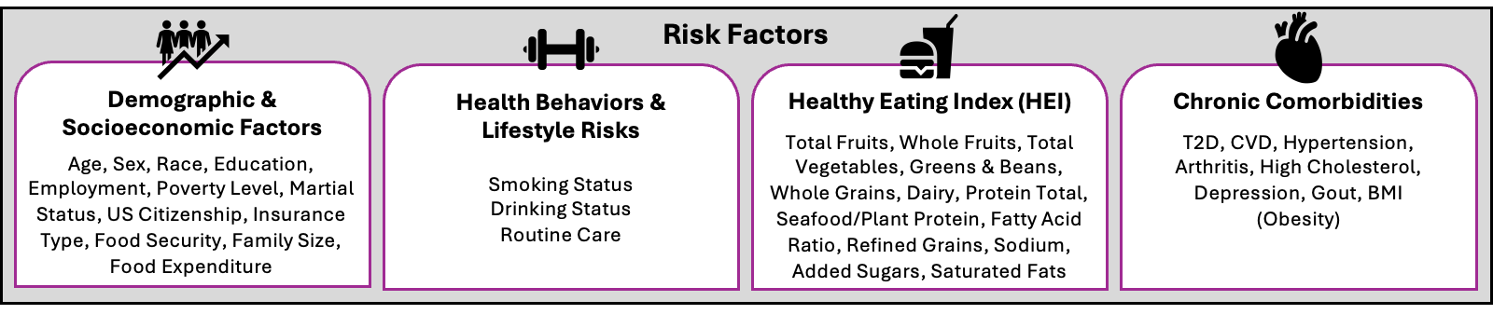
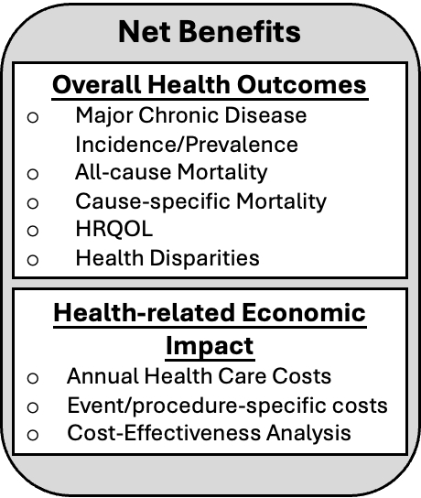
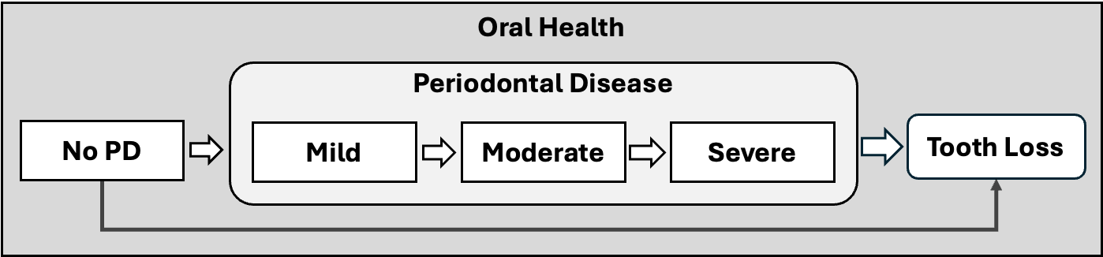
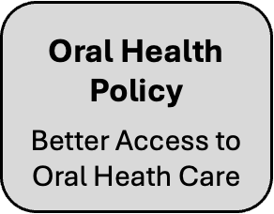
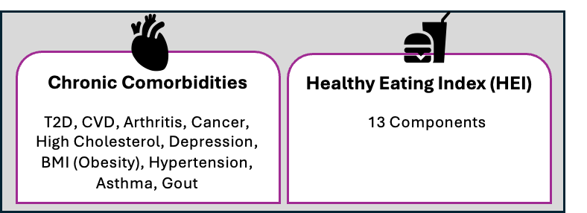
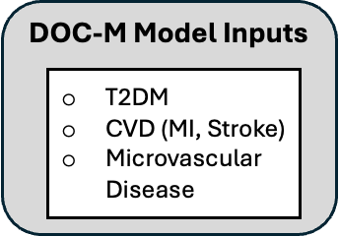
Direct effects on health
(mediated through intermediate outcomes)
DOC-M Model

Slide 34
Data Collection

Slide 35
Direct effects on health
(mediated through intermediate outcomes)
DOC-M Model

Slide 36
Sociodemographic Variables
Variable | Type | Unique Values / Categories | Notes
Age | Continuous | 30 to 80+ | NHANES dataset top-codes age at 80 years to protect participant privacy. Therefore, any individuals aged 80 or older are recorded as "80" in the dataset.
Sex | Categorical | Male, Female | /
Race | Categorical | White, Black, Hispanic, Other | Hispanic includes both Mexican American and Other Hispanic, while Other refers to Other Race - Including Multi-Racial.
Education | Categorical | < High School High School > High School | > High School includes 'Some College or AA degree' and 'College Graduate or above' High School refers to 'High School Grad/GED or Equivalent' < High School includes 'Less Than 9th Grade' and '9-11th Grade (Includes 12th grade with no diploma)'
Poverty Level | Categorical | < 100% FPL 100-199% FPL 200-399% FPL ≥ 400% FPL | Based on Federal Poverty Level (FPL). FPL categories are used in determining eligibility for U.S. programs like Medicaid, CHIP, and ACA subsidies [1][2][3]. Households: <100% FPL: in poverty 100-199%: partial aid 200-399%: limited aid ≥400%: often ineligible
Notes:
[1] PeopleKeep. (2024, January). Federal poverty guidelines: Definition, chart & explanation. https://www.peoplekeep.com/blog/federal-poverty-guidelines
[2] Jarvis Law Office. (2025). 2025 Medicaid income limits and guidelines. https://jarvisfirm.com/federal-poverty-level-2025-medicaid-income-limits-guidelines/
[3] HealthInsurance.org. (n.d.). Federal poverty level (FPL). https://www.healthinsurance.org/glossary/federal-poverty-level/

Slide 37
Sociodemographic Variables
Variable | Type | Unique Values / Categories | Notes
Marital Status | Categorical | Living with Partner, Living Alone, NA | Respondents were classified as living with a partner if they reported being married or living with a partner. Those who reported being widowed, never married, divorced, or separated were grouped as living alone. Responses marked as "Refused" or "Don't know" were coded as missing.
US Citizenship | Binary | 1, 0, NA | /
Family Size | Categorical | 1 to 7+ | /
Food Insecurity | Binary | 1, 0, NA | Individuals are classified as food insecure if either their household-level (FSDHH) or adult-level (FSDAD) food security falls into predefined low or very low food security categories.
Total Food Expenditure | Continuous | 0 - 171856 | Total household food expenditure is calculated as the sum of spending on food eaten at home (CBD070: groceries from supermarkets + CBD110: food from other stores) and away from home (CBD120: meals eaten out + CBD130: carryout or delivered foods), based on 30-day recall from NHANES CBQ data (2009–2014), with 777777 and 999999 recoded as missing values.
Food Exp. per Capita | Continuous | 0 - 34371.2 | Per capita food expenditure is derived by dividing total food expenditure by reported household size; for households marked as “7 or more”, size is conservatively set to 7.

Slide 38
Sociodemographic Variables
Variable | Type | Unique Values / Categories | Notes
Insurance Type | Categorical | Uninsured, Medicare, Private, Other, Medicaid, NA | Respondents were classified as insured (has_insurance = 1) or uninsured (has_insurance = 0) based on the binary response to HIQ011. Among those with insurance, specific insurance types were identified using the multi-response variables HIQ031A through HIQ031J. The classification scheme grouped insurance coverage into the following mutually exclusive categories: "Private": Covered by private insurance (HIQ031A). "Medicare": Covered by Medicare (HIQ031B). "Medicaid": Covered by Medicaid (HIQ031D). Other": Includes all remaining forms of public or supplemental coverage: HIQ031C: Medi-Gap supplemental insurance; HIQ031E: State Children's Health Insurance Program (SCHIP); HIQ031F: Military insurance; HIQ031G: Indian Health Service; HIQ031H: State-sponsored public health plans; HIQ031I: Other government insurance; HIQ031J: Single service plans
NHANES has not consistently collected dental insurance data in recent cycles. The last cycle with publicly available, direct dental insurance questions was NHANES III (1988–1994). Subsequent cycles did not include dedicated dental insurance variables.

Slide 39
Direct effects on health
(mediated through intermediate outcomes)
DOC-M Model

Slide 40
Health Behaviors & Lifestyle Risks
Variable | Type | Unique Values / Categories | Notes
Smoking Status | Categorical | Former, Current, Never, NA | Three-level NHANES Smoking Status Classification Never smoker: Respondent has smoked fewer than 100 cigarettes in their lifetime. Former smoker: Respondent has smoked ≥100 cigarettes but currently does not smoke. Current smoker: Respondent has smoked ≥100 cigarettes and currently smokes.
Drinking Status | Categorical | Former Drinker, Light Drinker,Heavy Drinker, Never Drinker, Moderate Drinker, NA | Never Drinker: <12 drinks in lifetime and never ≥12 in any one year. Former Drinker: ≥12 drinks in lifetime but no alcohol use in the past year. Current Drinker: ≥12 drinks in lifetime and some alcohol use in the past year, further divided into: Light Drinker: ≤3 drinks per week and not classified as heavy. Moderate Drinker: >3 drinks per week, not exceeding heavy thresholds. Heavy Drinker: Men: >14 drinks/week Women: >7 drinks/week OR ≥12 binge drinking days/year.

Slide 41
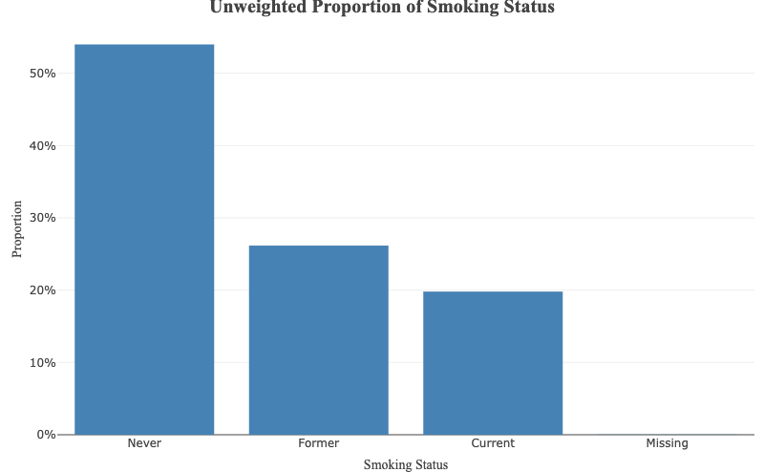
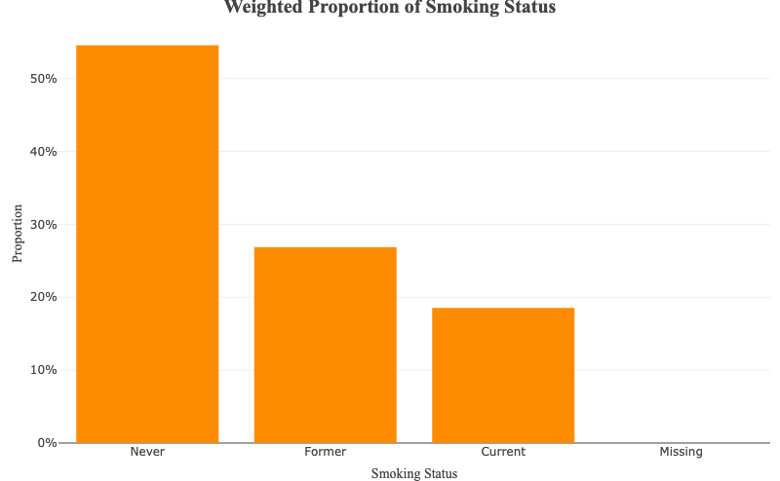
Health Behaviors & Lifestyle Risks

Slide 42
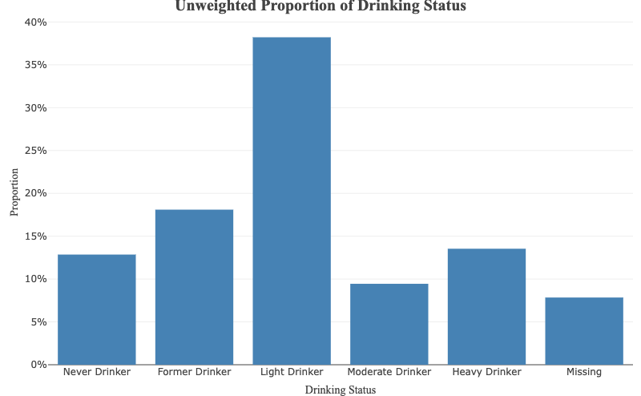
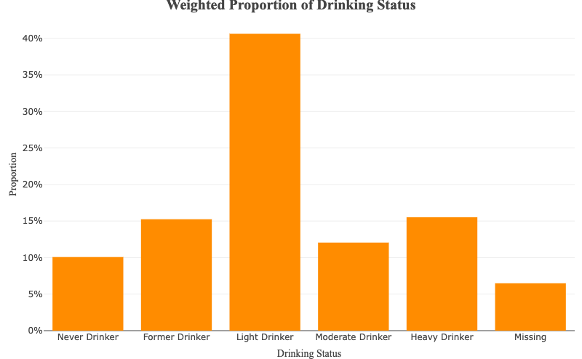
Health Behaviors & Lifestyle Risks

Slide 43
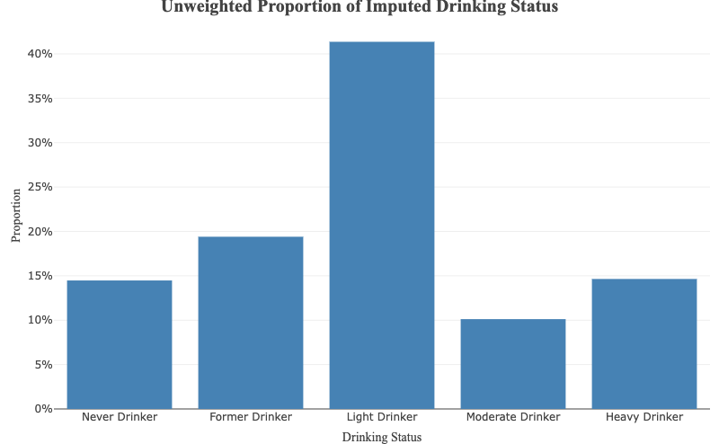
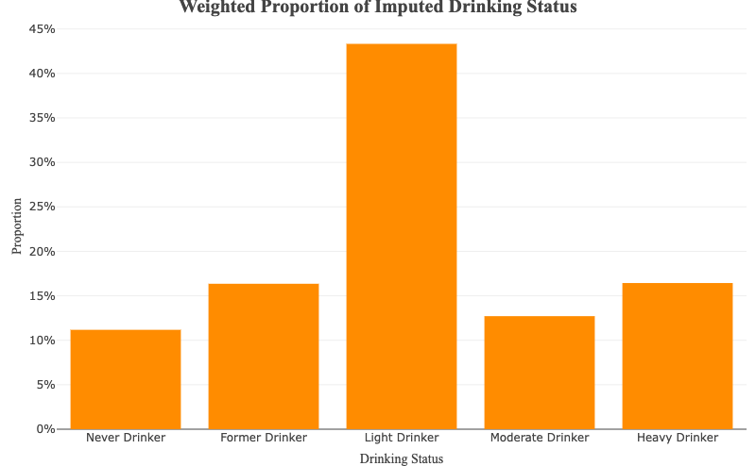
Health Behaviors & Lifestyle Risks

Slide 44
Health Behaviors & Lifestyle Risks
Variable | Type | Unique Values / Categories | Notes
Routine Care | Categorical | Optimal routine, Moderate routine, Minimal routine, NA | Data Source: Based on NHANES variables OHQ870 (flossing) and OHQ875 (mouthwash use), each measuring days per week (0–7). Categorisation: Both behaviours were classified as Low (0–1 days), Moderate (2–4 days), or High (5–7 days). Composite Definition: The Routine_Care variable combined these categories into three levels: Optimal routine: both High Moderate routine: one High and one Low/Moderate, or both Moderate Minimal routine: both Low or one Low and the other Moderate Missing Data Handling: If one measure was missing, the classification was based on the other; if both were missing, Routine_Care was set to missing.

Slide 45
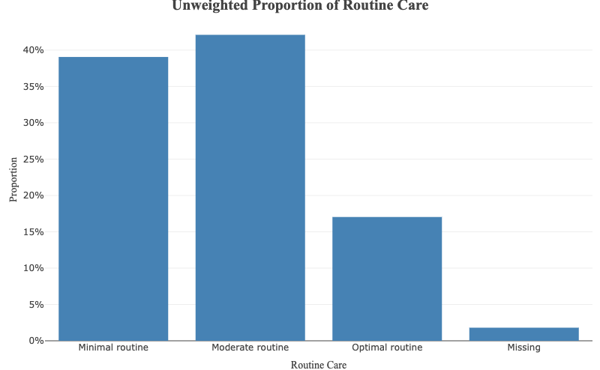
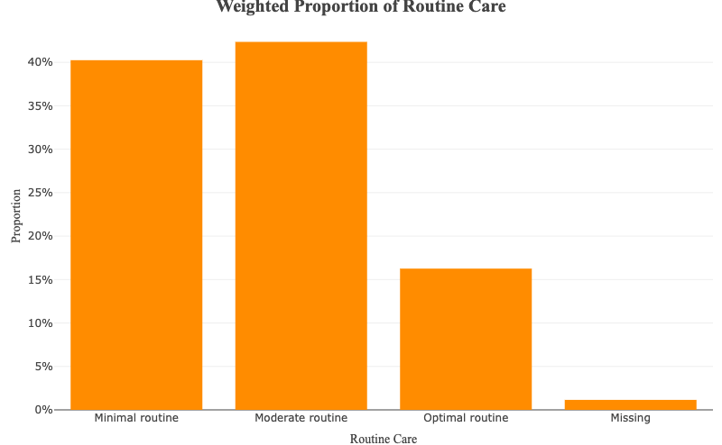
Health Behaviors & Lifestyle Risks

Slide 46
Direct effects on health
(mediated through intermediate outcomes)
DOC-M Model

Slide 47
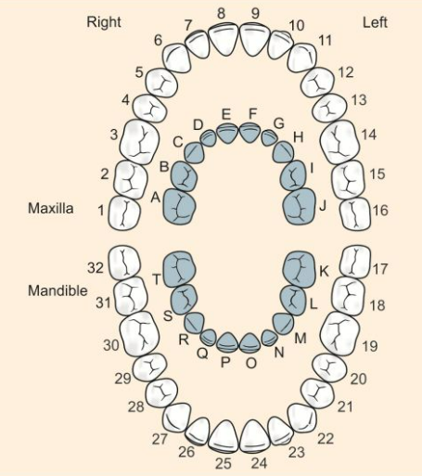
NHANES Variables for Periodontal Disease
Each NHANES periodontal measurement variable name encodes multiple pieces of information: the tooth, the site on the tooth, and the type of measurement. The general format is OHX[T][M][S], where:
[T] stands for tooth number (third molars 1/16/17/32 are excluded for potential absence and irregular alignments).
[M]: CJ captures gingival recession or overgrowth, PC records periodontal pocket depth (PD), and LA (clinical attachment loss) is calculated as CJ minus PD (CAL = CJ − PD). If the result is negative (e.g., gingival overgrowth beyond the CEJ), CAL is set to 0 to reflect no attachment loss.
[S] represents the six sites codes per tooth: D (distofacial), M (mid-facial), S (mesio-facial), P (disto-lingual), L (mid-lingual), A (mesio-lingual).
2013–2014 is the latest publicly released NHANES cycle with full-mouth periodontal variables, and combining it with the two preceding cycles (2009–2010 and 2011–2012) yields a six-year sample. This maximizes case counts while improves statistical precision.

Slide 48
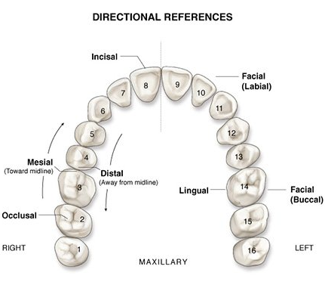
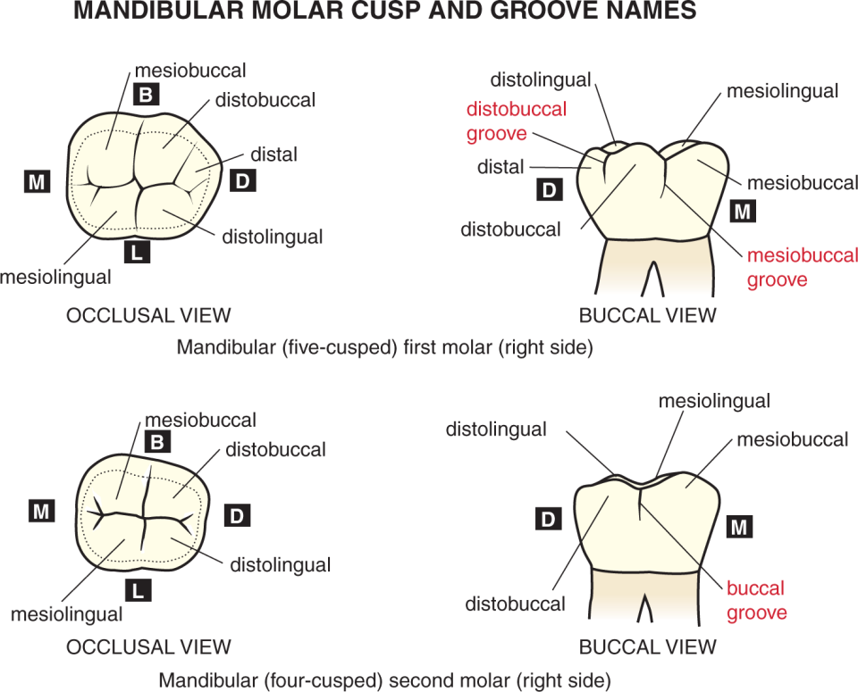
NHANES Variables for Periodontal Disease
Notes:
[1] https://www.google.com/url?sa=i&url=https%3A%2F%2Fpocketdentistry.com%2Ftype-traits-that-differentiate-mandibular-second-from-first-molars%2F&psig=AOvVaw0WAHWlVTg1AhuLB14Ghu9P&ust=1745976704299000&source=images&cd=vfe&opi=89978449&ved=0CBQQjRxqFwoTCLjwlZyM_IwDFQAAAAAdAAAAABAE

Slide 49
NHANES Variables for Periodontal Disease
NHANES Periodontitis classification
Use only inter-proximal readings (mesial = S/A, distal = D/P).
Flag teeth that exceed thresholds (CAL ≥ 6 mm & PD ≥ 5 mm, CAL ≥ 4 mm, PD ≥ 5 mm).
Severe = ≥ 2 teeth CAL ≥ 6 mm and ≥ 1 tooth PD ≥ 5 mm; Moderate = ≥ 2 teeth CAL ≥ 4 mm or ≥ 2 teeth PD ≥ 5 mm; others → None/Mild.
Edentulous adults assigned to None/Mild to avoid over-estimating disease.
Why only mesial/distal sites?
Inter-proximal areas are where periodontitis typically begins and progresses.
Excluding mid-facial/lingual (M/L) prevents false positives from isolated recession or overgrowth, aligning with CDC-AAP surveillance standards.
* Classification standard chosen: Although the 2017 World Workshop / 2018 EFP-AAP “Stage & Grade” system is now preferred clinically—requiring radiographic bone-loss percentages—NHANES lacks those inputs; therefore, the analysis uses the fully implementable CDC-AAP 2012 interproximal CAL/PD surveillance rule.
Notes:
CDC/AAP case definitions
Mild periodontitis level: at least 2 sites with CAL ≥3 mm and at least 2 sites with PD ≥4 mm (not on the same tooth), or one site with PD ≥5 mm​.
Moderate periodontitis level: at least 2 interproximal sites with CAL ≥4 mm (not on the same tooth) OR at least 2 interproximal sites with PD ≥5 mm (not on the same tooth).
Severe periodontitis level: at least 2 interproximal sites with CAL ≥6 mm (not on the same tooth) AND at least 1 interproximal site with PD ≥5 mm.

Slide 50
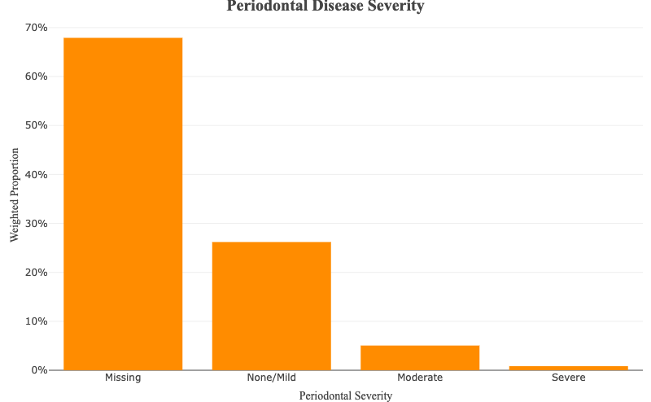
MICE-based Method for Data Imputation
Strict Imputation-Based Classification: We use a conservative approach where any missing tooth-level CAL or PD value results in an unclassified (NA) periodontal severity status.
High Missingness in Raw Data: Due to substantial missingness in NHANES dental exams, many participants are unclassifiable under this strict rule unless missing values are imputed.
Visual Comparison: This chart compares the original severity variable (based on partial data) to the imputed version, highlighting the impact of stricter missing data handling.

Slide 51
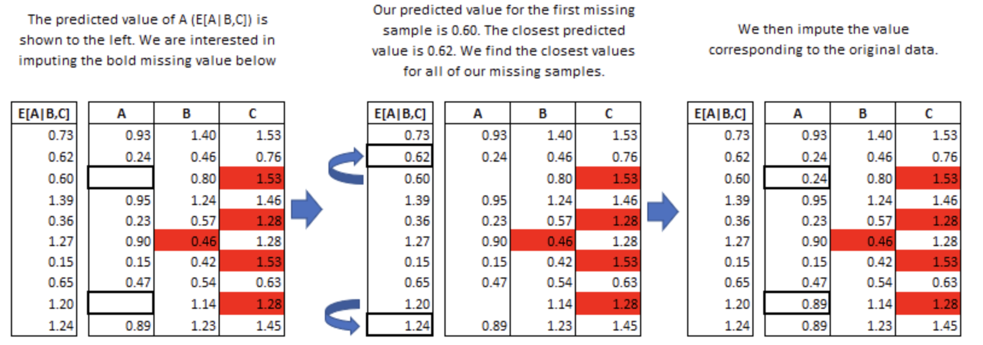
MICE-based Method for Data Imputation
Multiple imputation (MI) by chained equations (MICE) is a widely applied method for imputing missing clinical data
key assumption: values in dataset missing at random
imputes the missing data by consulting on observations of other variables
drawing plausible values from the models → updating the model parameters sequentially across each variable → convergence / reach max # iteration
10 datasets, 50 iterations, pooling for final result
Two most popular methods for imputation:
Predictive mean matching (PMM):
Using closest predicted value
Useful for imputing values that are: Multimodal/Integer/Skewed
Classification and regression trees (CARTs):
Using other covariates as predictors
Useful for imputing values that are: Continuous/Bimodal
Source: https://cran.r-project.org/web/packages/miceRanger/vignettes/miceAlgorithm.html

Slide 52
MICE-based Method for Data Imputation
The Imputation approach this research used is based on a validated model (Zhang et al. 2024)
The key covariates for MICE are: "age", "sex", "race", "number of missing teeth", "Current Smoker Status" and 4 oral health questionnaires, where
Propensity Score Model for Smoking (used in validation):
Variable | Question
OHQ835 | {Do you/Does SP} think {you/s/he} might have gum disease?
OHQ850 | {Have you/Has SP} ever had treatment for gum disease such as scaling and root planing, sometimes called "deep cleaning"?
OHQ855 | {Have you/Has SP} ever had any teeth become loose on their own, without an injury
OHQ860 | {Have you/Has SP} ever been told by a dental professional that {you/s/he} lost bone around [your/his/her} teeth?
Source: https://journals.sagepub.com/doi/10.1177/23800844241228277

Slide 53
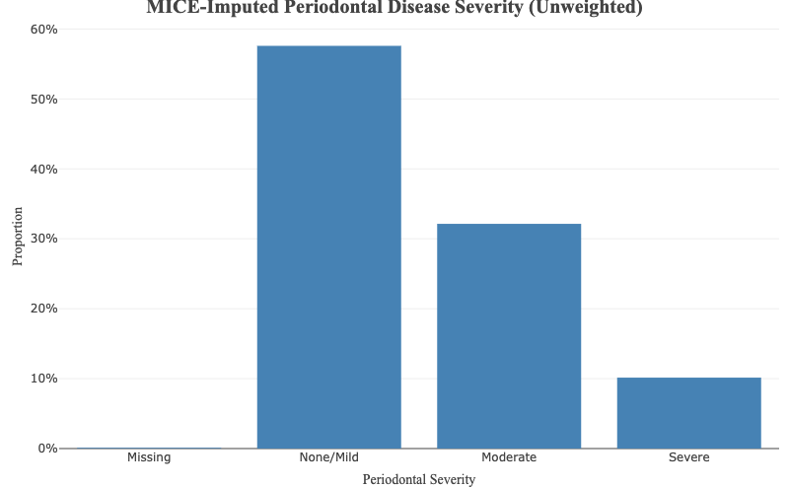
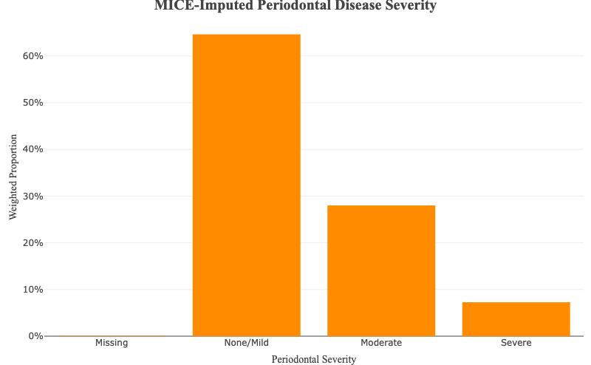
MICE-based Method for Data Imputation
Notes:
For the imputed Periodontal Disease groups, we also applied weights to the test subjects according to the four questionnaire questions to account for population level outcome

Slide 54
NHANES Variables for Tooth Loss
Variable format: OHX + ## + TC
OHX = Oral Health Exam file prefix
## = tooth number 01-32
TC = Tooth Count status (Permanent tooth present, Primary (deciduous) tooth present, Tooth not present, Dental implant, Permanent dental root fragment present)
Wisdom teeth excluded: third molars (01, 16, 17, 32) are dropped from analyses.
Tooth-count rule: only Permanent tooth present contributes to the numeric tooth-count; implants, roots, and primary teeth are not counted.
Tooth-loss thresholds (excluding third molars)
0 teeth lost (all 28 present)
1–5 teeth lost
6–20 teeth lost (less than 20 remaining, not functionally dentate)
Edentulous (all teeth lost)

Slide 55
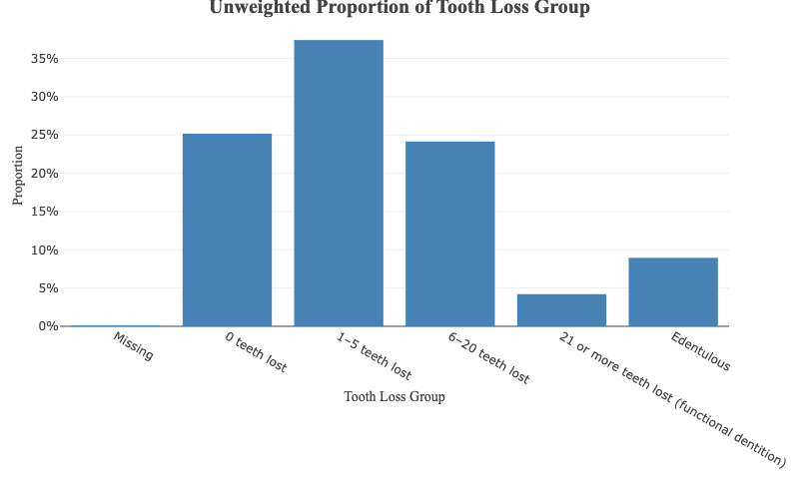
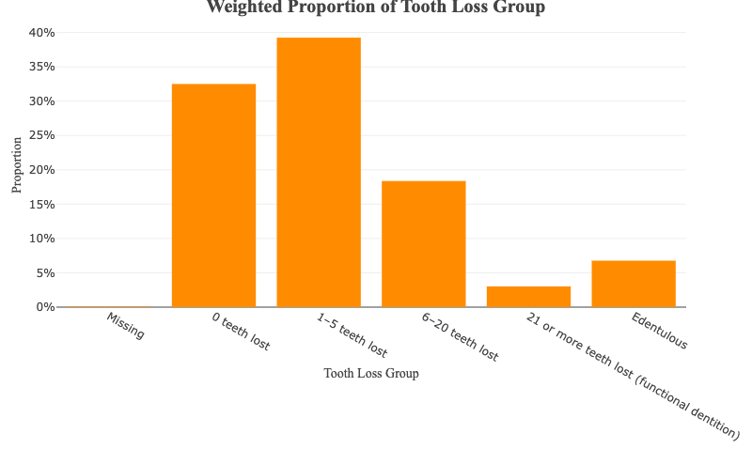
NHANES Variables for Tooth Loss

Slide 56
Direct effects on health
(mediated through intermediate outcomes)
DOC-M Model

Slide 57
Constructing HEI-2020 Scores from NHANES 2009–2014
What is the Healthy Eating Index?
The Healthy Eating Index (HEI) is a scoring metric that can be used to determine overall diet quality as well as the quality of several dietary components
Data Sources:
NHANES 24-hour dietary recall: First-day data (DR1IFF Individual Foods File and DR1TOT Total Nutrient Intake File) are used for population-level reliability, as only Day 1 is collected in-person with higher response rates.
USDA Food Patterns Equivalents Database (FPED 2009–2014)
Scoring Framework: HEI-2020
13 components:
Adequacy (encouraged intake): Total Fruit, Whole Fruit, Vegetables, Greens & Beans, Whole Grains, Dairy, Protein, Seafood & Plant Proteins, Fatty Acids
Moderation (limited intake): Refined Grains, Sodium, Added Sugars, Saturated Fat
Component scores expressed per 1000 kcal or as %kcal, with a total score out of 100
Notes:
[1] https://www.fns.usda.gov/cnpp/hei-scores-americans
[2] https://epi.grants.cancer.gov/hei/evaluation-validation.html

Slide 58
Constructing HEI-2020 Scores from NHANES 2009–2014
Why Use Day 1 Only?
NHANES Day 1 recall is administered in-person, ensuring higher data quality
More complete response rate and lower reporting error vs. Day 2 (often phone-based)
Ensures uniformity across all cycles, as not all participants complete Day 2
Prior studies (e.g., USDA reports) support validity of Day 1 for population-level diet quality
The multivariate Markov Chain Monte Carlo (MCMC) method for calculating HEI scores involves:
Separate modeling of each dietary constituent (e.g., whole fruits, dark green vegetables) to avoid overlap or collinearity
Joint simulation of all HEI components and energy intake using a multi-part model, accounting for correlations between components, skewness, and episodic consumption patterns
Monte Carlo steps to generate pseudo-individual intake distributions, which are then scored using HEI standards to estimate population-level diet quality distributions
Why HEI-2020 (vs. HEI-2015): Reflects the latest U.S. Dietary Guidelines (2020–2025), with a stronger emphasis on healthy fats (via updated fatty acid ratio), and refined scoring to better capture plant-forward diets and nuances in protein and grain intake [1] [2].
Notes:
[1] https://wwwn.cdc.gov/nchs/nhanes/tutorials/dietaryanalyses.aspx
[2] https://epi.grants.cancer.gov/hei/sas-code.html
[3] https://epi.grants.cancer.gov/hei/evaluation-validation.html
[4] https://pmc.ncbi.nlm.nih.gov/articles/PMC7042025/

Slide 59
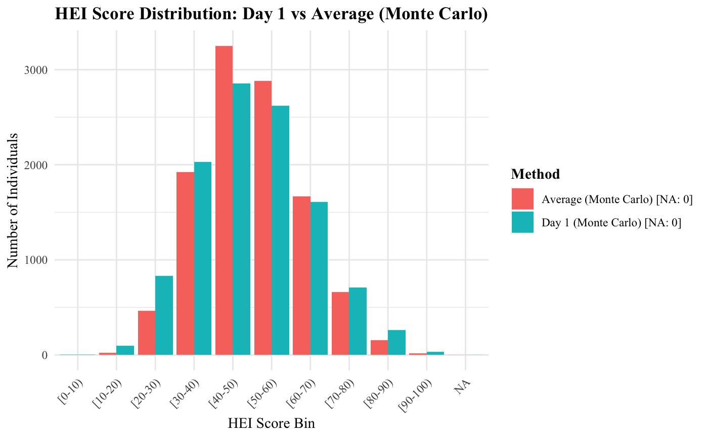
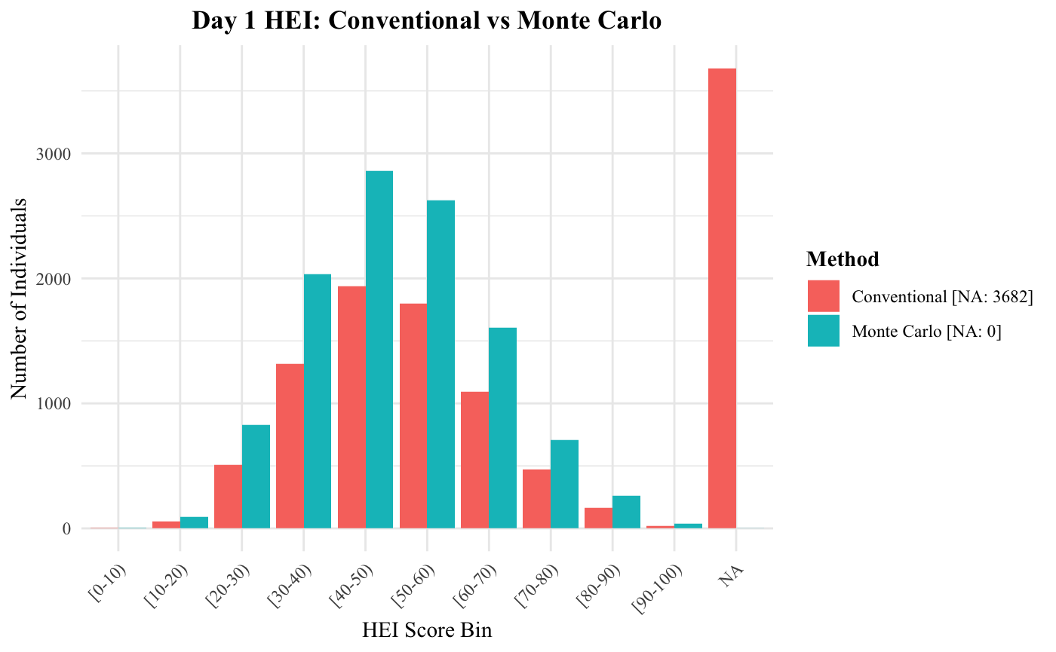
Constructing HEI-2020 Scores from NHANES 2009–2014
Monte Carlo HEI estimates (e.g., day1_mc_mean) have fewer missing values because they use simulation or multiple imputation to handle incomplete or uncertain dietary recall data, unlike conventional HEI scores which require fully observed inputs for all components.

Slide 60
Direct effects on health
(mediated through intermediate outcomes)
DOC-M Model

Slide 61
Chronic Comorbidities
Variable | NHANES Variable | Definitions
Diabetes (T2D) | DIQ010 – “Ever told you had diabetes” DIQ050 – “Now taking insulin” DIQ070 – “Now taking diabetic pills” LBXGLU – Fasting Plasma Glucose (FPG) LBXGLT – 2-Hour Oral Glucose Tolerance Test (OGTT) LBXGH – Glycohemoglobin (HbA1c) | Based on the American Diabetes Association (ADA) Standards of Care in Diabetes—2023, diabetes is diagnosed if any of the following criteria are met: Fasting Plasma Glucose (FPG): ≥ 126 mg/dL (7.0 mmol/L) 2-Hour Plasma Glucose (OGTT): ≥ 200 mg/dL (11.1 mmol/L) HbA1c: ≥ 6.5% (48 mmol/mol) Random Plasma Glucose: ≥ 200 mg/dL (11.1 mmol/L) in individuals with classic symptoms of hyperglycemia or hyperglycemic crisis.
Asthma | MCQ010 – “Has a doctor or other health professional ever told you that you had asthma?” | asthma (binary: 1 = Yes, 0 = No, NA = Unknown)
Arthritis | MCQ160A – “Has a doctor or other health professional ever told you that you had arthritis?” | arthritis (binary: 1 = Yes, 0 = No, NA = Unknown)
Cancer | MCQ220 – “Have you ever been told by a doctor or other health professional that you had cancer or a malignancy of any kind?” | cancer (binary: 1 = Yes, 0 = No, NA = Unknown)

Slide 62
Chronic Comorbidities
Variable | NHANES Variable | Definitions
Gout | MCQ160N – “Has a doctor or other health professional ever told you that you had gout?” | Gout (binary: 1 = Yes, 0 = No, NA = Unknown)
High Cholesterol | BPQ080 – “Have you ever been told by a doctor or other health professional that your blood cholesterol level was high?” | high_chol (binary: 1 = Yes, 0 = No, NA = Unknown)
Depression | DPQ010 to DPQ090: These represent the 9 questions of the PHQ-9 (Patient Health Questionnaire), which ask how often a person has experienced specific depressive symptoms over the past two weeks. Response options: "Not at all" → 0 "Several days" → 1 "More than half the days" → 2 "Nearly every day" → 3 "Refused" or "Don't know" → NA | Each of the 9 symptom questions is assigned a score from 0 to 3. These are summed to produce a PHQ-9 total score (0–27). 0–4: Minimal depression 5–9: Mild depression 10–14: Moderate depression 15–19: Moderately severe depression 20–27: Severe depression

Slide 63
Chronic Comorbidities
Variable | NHANES Variable | Definitions
BMI (Obesity) | BMXBMI – This is the measured Body Mass Index (BMI) variable, calculated from height and weight during the physical exam. | BMI Classification (CDC Standard for Adults) Underweight: BMI < 18.5 Normal weight: BMI ≥ 18.5 and < 25 Overweight: BMI ≥ 25 and < 30 Obese: BMI ≥ 30
Hypertension | Self-reported variables used: BPQ020: “Have you ever been told by a doctor or health professional that you had hypertension, also called high blood pressure?” BPQ040A: “Are you now taking prescribed medicine for high blood pressure?” Exam-based variables used: Systolic blood pressure: BPXSY1 to BPXSY4 Diastolic blood pressure: BPXDI1 to BPXDI4 Averages calculated as: mean_sys = average of systolic readings mean_dia = average of diastolic readings | Classification logic: A participant is classified as having hypertension (1) if: Self-reported diagnosis (BPQ020 == 1), or Self-reported current medication use (BPQ040A == 1), or Mean systolic BP ≥ 130 mmHg, or Mean diastolic BP ≥ 80 mmHg If all indicators are missing → NA Otherwise → 0 (no hypertension) American College of Cardiology (ACC) / American Heart Association (AHA) 2017 guideline: ≥130 mmHg systolic, or ≥80 mmHg diastolic

Slide 64
Chronic Comorbidities
Variable | NHANES Variable | Definitions
CVD | Congestive Heart Failure (CHF): MCQ160B – “Has a doctor or other health professional ever told you that you had congestive heart failure?” Coronary Heart Disease (CHD): MCQ160C – “Has a doctor or other health professional ever told you that you had coronary heart disease?” Angina (angina pectoris): MCQ160D – “Has a doctor or other health professional ever told you that you had angina, also called angina pectoris?” Heart Attack (Myocardial Infarction, MI): MCQ160E – “Has a doctor or other health professional ever told you that you had a heart attack?” | A participant is classified as having CVD = 1 if they answered “Yes” to any one of the four questions above. If all responses are missing → CVD = NA If all are “No” → CVD = 0

Slide 65
Methodology & Result

Slide 66
Direct effects on health
(mediated through intermediate outcomes)
DOC-M Model

Slide 67
Modeling Periodontal Disease
Periodontal disease (PD) is a chronic inflammatory condition affecting the tissues surrounding teeth, and it is a leading cause of adult tooth loss. Early identification of individuals at risk of severe PD can help constitute a strong set of predictors for modeling tooth loss, which further informs the overall health outcome.
Key Assumptions: In our model, we chose severe PD, a binary variable derived from the three-way categorization of PD status based on severity, namely None/Mild, Moderate, and Severe, as our outcome variable (Y) based on the following clinical and analytical assumptions:
Tooth Loss Relevance
Severe PD is the only stage strongly associated with significant tooth loss. Since tooth count is a downstream consequence of PD, modeling severe PD aligns with understanding irreversible oral damage.
Disease Progression Continuum
Periodontal disease follows a progressive path — from mild to moderate to severe. By focusing on the final stage, we capture the cumulative burden of risk factors, making severe PD a meaningful and integrated endpoint for prediction.

Slide 68
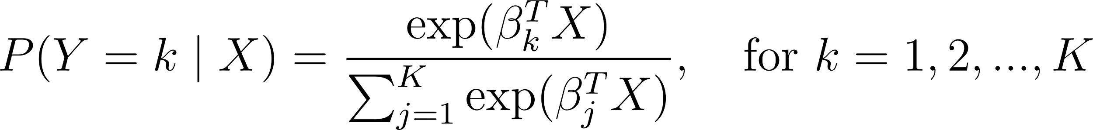
Modeling Periodontal Disease
Given our assumptions about the clinical significance and progression of periodontal disease, we model severe PD as the outcome of interest (Y), which is either a binary (severe vs. not severe) or a categorical variable (None/Mild, Moderate, Severe). To predict PD status, we employ three modeling approaches:
1️. Multinomial Logistic Regression
A generalized linear model that estimates the probability of each outcome class using a linear combination of predictors and a softmax function. The formula is as follows: For class k,
Why We Use It:
Interpretable and transparent.
Useful for understanding marginal effects of individual predictors.
A solid baseline for comparing more complex models.

Slide 69
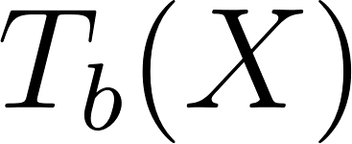
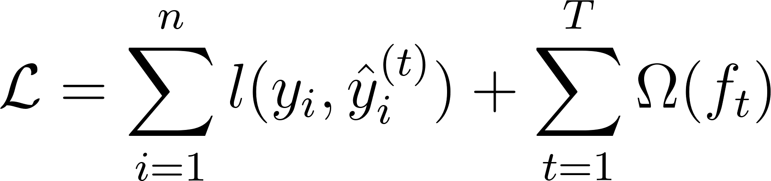

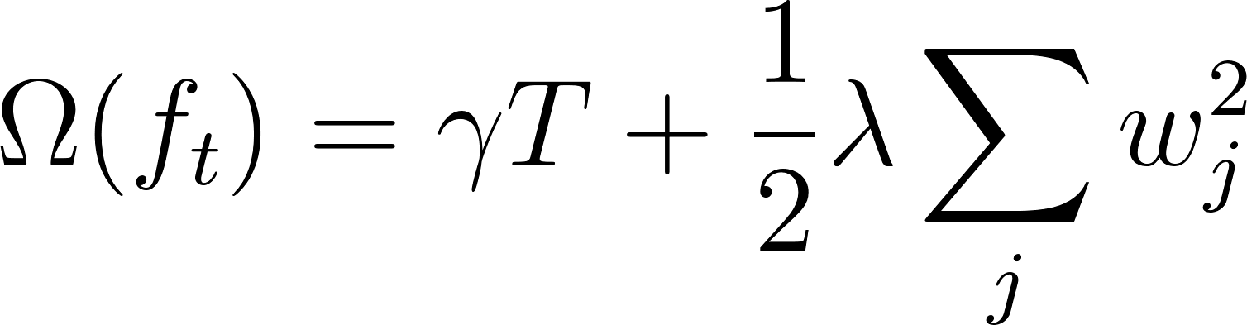
Modeling Periodontal Disease
2. Random Forest
An ensemble learning method that builds multiple decision trees using bootstrap samples and random subsets of features, then aggregates their predictions.
Where is the prediction from the b-th tree in the forest.
3. Extreme Gradient Boosting (XGBoost)
A gradient boosting framework that builds trees sequentially, where each new tree corrects the residual errors of the ensemble so far, optimized using second-order (Newton) approximation.
Where:
is the loss function (e.g., softmax log-loss for multiclass)
​ is a regularization term to penalize model complexity.
Model | Strengths | Use Case in PD Prediction
Logistic Regression | Interpretable, baseline comparison | Understanding marginal effects
Random Forest | Nonlinear modeling, robust to noise | Capturing complex interactions
XGBoost | High accuracy, regularized, state-of-the-art performance | Best for maximizing predictive performance

Slide 70
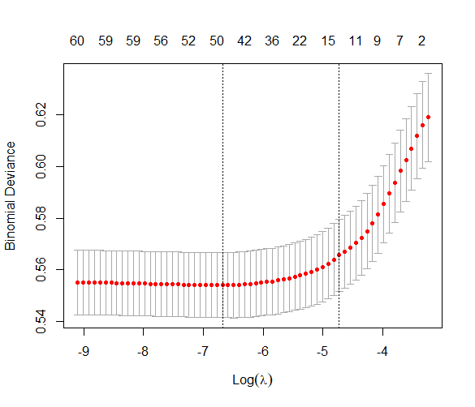
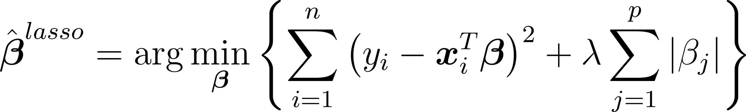
LASSO Regression for Variable Selection
LASSO (Least Absolute Shrinkage and Selection Operator) is a linear regression technique that uses a penalty term to shrink coefficients towards zero and can even set some to exactly zero, effectively performing feature selection. This helps to prevent overfitting and can improve model interpretability by reducing the number of features used.
Mathematical Formulation:
Where:
λ is the regularization parameter
Larger λ encourages more coefficients to shrink exactly to zero
Method: Use 10-fold Cross-Validation testing 100 values to identify the optimal level of regularization (λ) that minimizes out-of-sample error.
λ.min = 0.00126: Minimizes the binomial deviance.
λ.1se = 0.00886: More conservative; within 1 standard error of the minimum deviance (used to prevent overfitting).

Slide 71
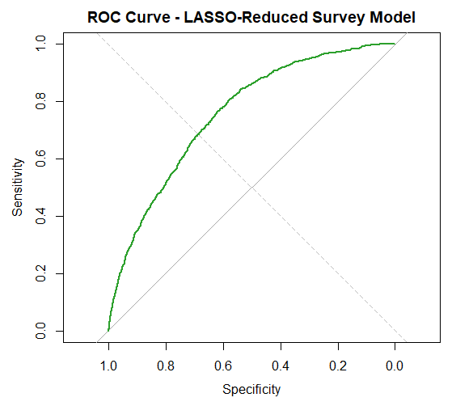
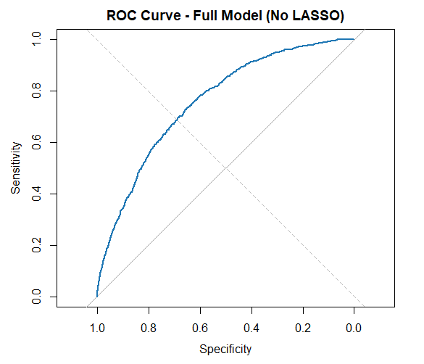
LASSO Regression for Variable Selection
Selected Predictors by LASSO – Covering all four categories
Demographics: sex, race, age
Socioeconomic: education, poverty_level, insurance_type
Health Behaviors: smoking_status, imputed_drinking_status
Comorbidities: diabetes, hypertension, asthma
Interpretations:
Nearly identical AUCs indicate the reduced model is just as effective.
This confirms that the additional variables in the full model provide minimal incremental value.
Model Type | AUC Score | NO. of Predictors
LASSO-Reduced Model | 0.7551 | 11
Full Model (No LASSO) | 0.7572 | 38
Notes:
Selected/Filtered predictors has nothing to do with the level of significance: LASSO turns the coefficient to 0 solely based on the accuracy (MSE). Some significant predictors might be filtered and some insignificant predictors might be kept.

Slide 72
LASSO Regression for Variable Selection
Selected Predictors by LASSO – Covering all four categories
Demographics: sex, race, age
Socioeconomic: education, poverty_level, insurance_type
Health Behaviors: smoking_status, imputed_drinking_status
Comorbidities: diabetes, hypertension, asthma
Interpretations:
Nearly identical AUCs indicate the reduced model is just as effective.
This confirms that the additional variables in the full model provide minimal incremental value.
Model Type | AUC Score | NO. of Predictors
LASSO-Reduced Model | 0.7551 | 11
Full Model (No LASSO) | 0.7572 | 38

Slide 73
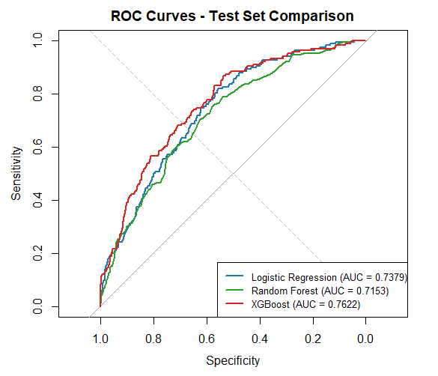
Modeling Periodontal Disease – Advanced ML Models
Although LASSO Regression is useful in reducing overfitting, it does not improve the accuracy of prediction. In addition, it is usually applied to generalized linear models. Therefore, we keep the full set of predictors to run the other two advanced machine learning models, i.e., Random Forest and XGBoost, to obtain optimal model performance.
Implementation Note:
To account for overfitting and avoid bias due to data leakage (evaluating on training data), we do a 80/20 train-test split.
For the logistic regression model, we include a survey design to account for sampling weights so that the coefficients reflect population-level effects.
For Random Forest and XGBoost, we use cross-validation on training set to tune the hyperparameters.
Key Findings:
XGBoost is the best performing model, suggesting it best captures non-linear patterns and complex interactions in the data.
Logistic Regression confirms much of the linear predictive structure.
Notes:
The NHANES dataset we used is based on a complex survey design, which includes:
Stratification (grouping population by similar traits),
Clustering (selecting groups rather than individuals),
Unequal sampling probabilities (certain groups are oversampled).
Ignoring this design can lead to biased estimates and invalid inference.

Slide 74
Direct effects on health
(mediated through intermediate outcomes)
DOC-M Model

Slide 75
Modelling Tooth Count Data
In many public health, epidemiological, and behavioral studies, the outcome of interest is a count variable—a non-negative integer representing the number of times an event occurs. In our study, the dependent variable is tooth count, representing how many natural teeth a person has.
Linear regression is inappropriate for count outcomes since the outcome variable violates key assumptions of linear regression, such as：
Normality: The count variable is often skewed and does not follow a normal distribution.
Homoscedasticity: Variance of counts typically increases with the mean.
Continuity: Tooth count is a discrete value, while linear regression assumes a continuous dependent variable.
Why Poisson and Negative Binomial Regression work?
Poisson Regression assumes that the mean and variance of the count variable are equal (equidispersion). It is appropriate for data where the event rate is constant.
Negative Binomial Regression is an extension of Poisson regression that allows for overdispersion—when the variance exceeds the mean, a common feature in real-world count data.
Both models allow us to handle non-negative integers, incorporate log-link functions to model expected counts, and allow interpretation through incident rate ratios (IRRs).
Notes:
In many public health, epidemiological, and behavioral studies, the outcome of interest is a count variable—a non-negative integer representing the number of times an event occurs. In our study, the dependent variable is tooth count, representing how many natural teeth a person has.
Modeling such outcomes requires techniques that account for the discrete and non-negative nature of count data. The traditional linear regression model is not appropriate here because it assumes normally distributed errors and continuous outcomes, which are violated when the response variable is a count. Instead, specialized models like the Poisson regression and its extension, the Negative Binomial regression, are used.

Slide 76
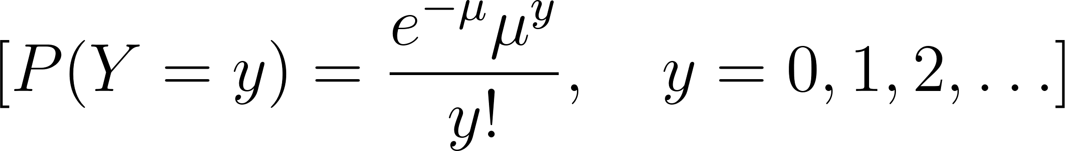
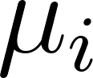
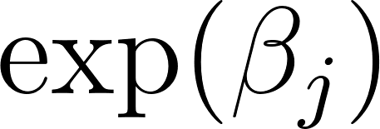
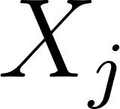
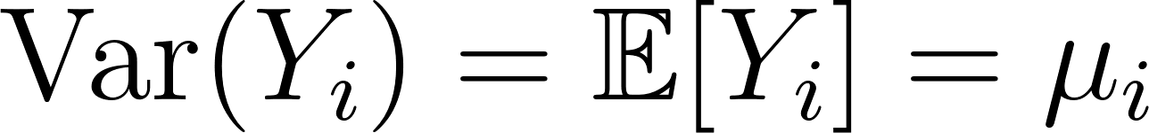
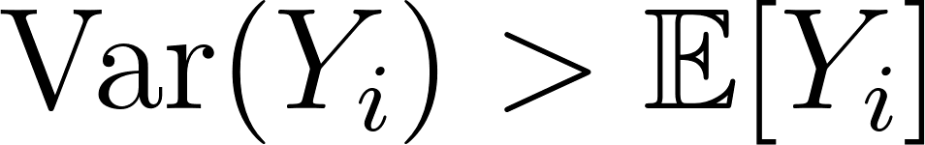
The Poisson Regression Model
The Poisson model is the classical method for modeling count outcomes. It assumes that the number of events Y follows a Poisson distribution with mean μ, such that:
In regression form, we link the mean count for observation i to a linear combination of covariates through the log link function: ,
which implies:
Each exponentiated coefficient is interpreted as the multiplicative effect on the expected count when increases by one unit, holding other variables constant.
Assumptions and Limitations of the Poisson Model
The key assumption of the Poisson distribution is that:
This implies that the variance and mean are equal—an assumption that rarely holds in real-world data. This strict constraint leads to potential problems when the observed data exhibit overdispersion, i.e.,
Why is Overdispersion a Problem?
Underestimated standard errors
Inflated test statistics
P-values too small, leading to false positives
Narrow confidence intervals
Notes:
The Poisson model assumes that the counts follow a Poisson distribution. This is useful when modeling rare events or frequencies.
📌 Poisson Distribution Formula:
The probability of observing kk events when the average rate is λ\lambda is:
P(Y=k)=λke−λk!P(Y = k) = \frac{\lambda^k e^{-\lambda}}{k!}
Y is the count variable
e is the expected rate (mean) of events
y is a non-negative integer (0, 1, 2, ...)
When we want to model counts as a function of explanatory variables, you use Poisson regression, a type of Generalized Linear Model (GLM).
🔧 Model Specification:
log⁡(λi)=β0+β1xi1+β2xi2+⋯+βpxip\log(\lambda_i) = \beta_0 + \beta_1 x_{i1} + \beta_2 x_{i2} + \dots + \beta_p x_{ip}
mu_i: expected count for observation i
xijx_{ij}: predictor variables
βj\beta_j: coefficients to be estimated
Note: the log link function ensures that mu > 0
Use it when:
You're modeling counts (e.g., number of calls, crimes, defects)
The counts are non-negative integers
The variance is roughly equal to the mean (if variance >> mean, consider a Negative Binomial model)

Slide 77
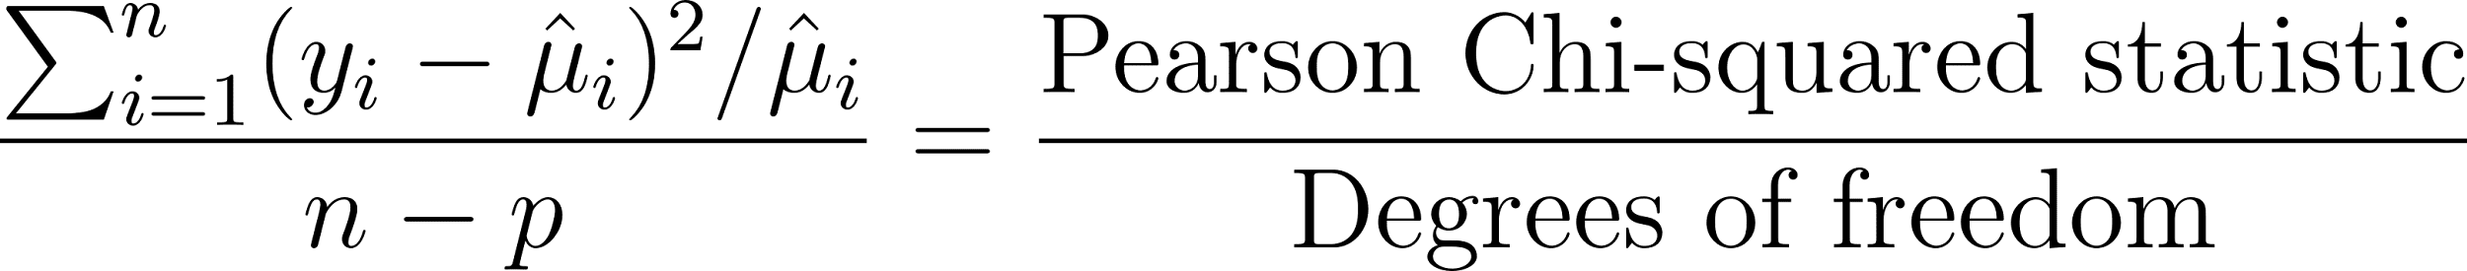
Overdispersion in Poisson Regression Model
Diagnosing Overdispersion
The overdispersion in a Poisson model was diagnosed by computing the dispersion statistic, defined as:
If this statistic is close to 1, the Poisson model is appropriate. But if it exceeds 1.5–2, overdispersion is present, and a Poisson model is no longer valid.
Diagnosing Result
The overdispersion statistic was 3.01, far above the acceptable threshold.
This suggested excess variability in the data, potentially due to unmeasured heterogeneity or clustering (e.g., age, comorbidities).
Using the Poisson model would have underestimated standard errors, leading to spurious findings.
Negative Binomial model
Accounts for the observed overdispersion
Produces more accurate standard errors and p-values
Improves model fit (AIC dropped significantly from Poisson to NB)
Still allows us to interpret results using Relative Risks

Slide 78
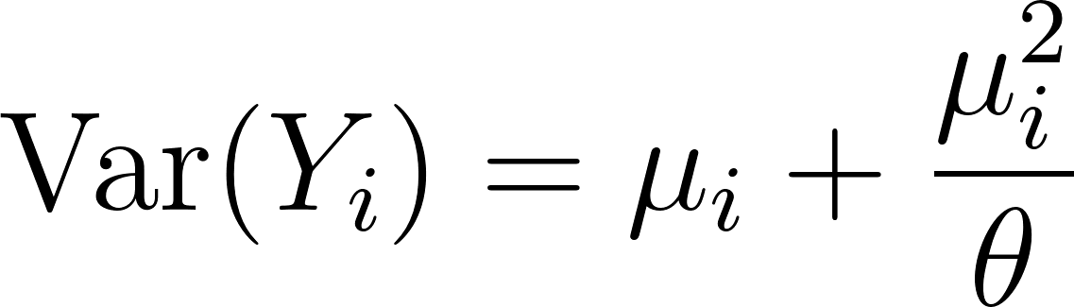

The Negative Binomial Model
The Negative Binomial (NB) regression is a natural extension of the Poisson model that relaxes the mean-variance equality. It assumes:
Where θ is a positive dispersion parameter:
As , the variance approximates the mean, and the NB model becomes equivalent to Poisson.
When θ is small, the model accounts for substantial overdispersion.
NB regression uses the same log link function as Poisson:
But allows for additional variation, making it a more flexible and robust approach for overdispersed count data.

Slide 79
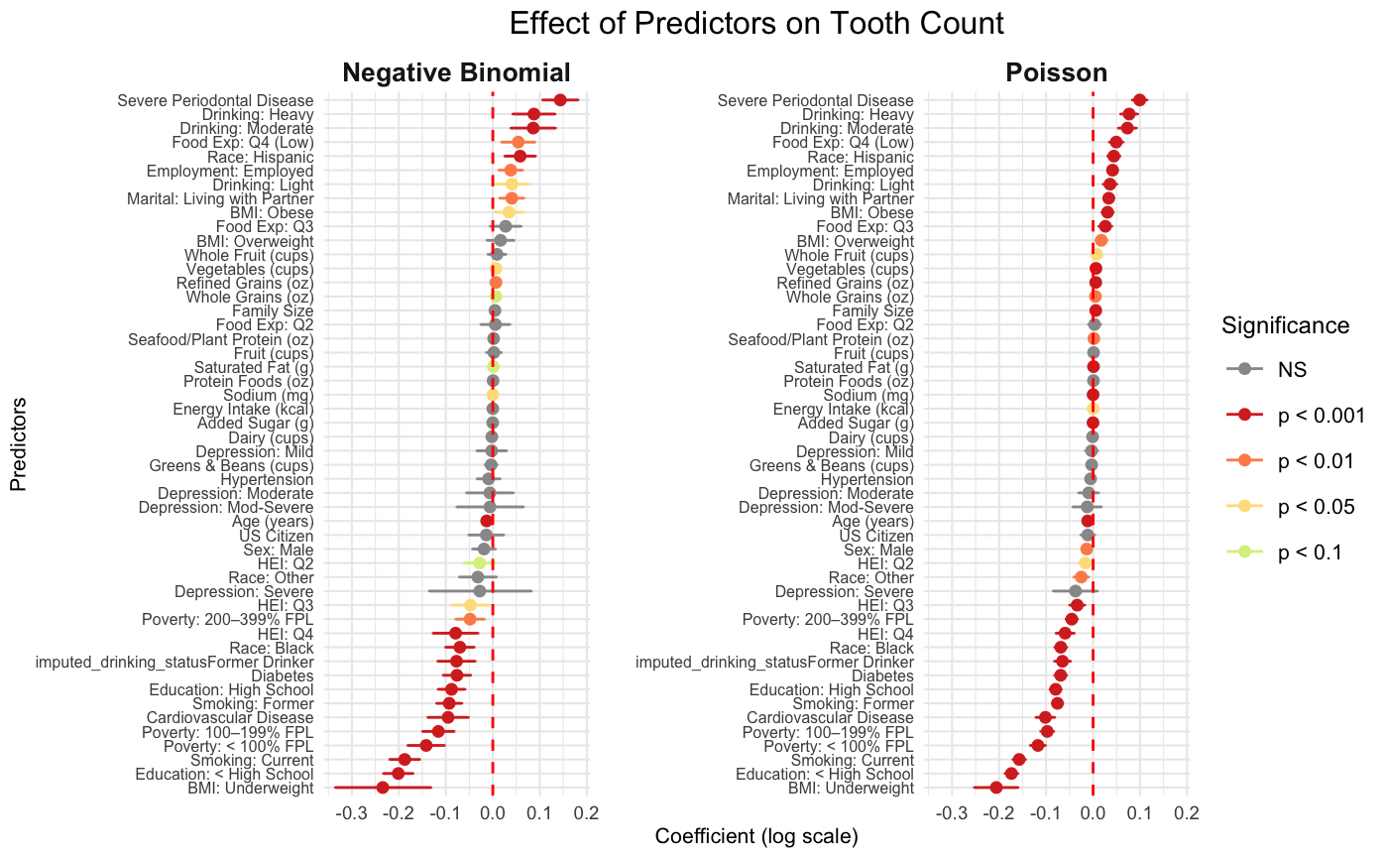
Poisson Model & Negative Binomial Model Results

Slide 80
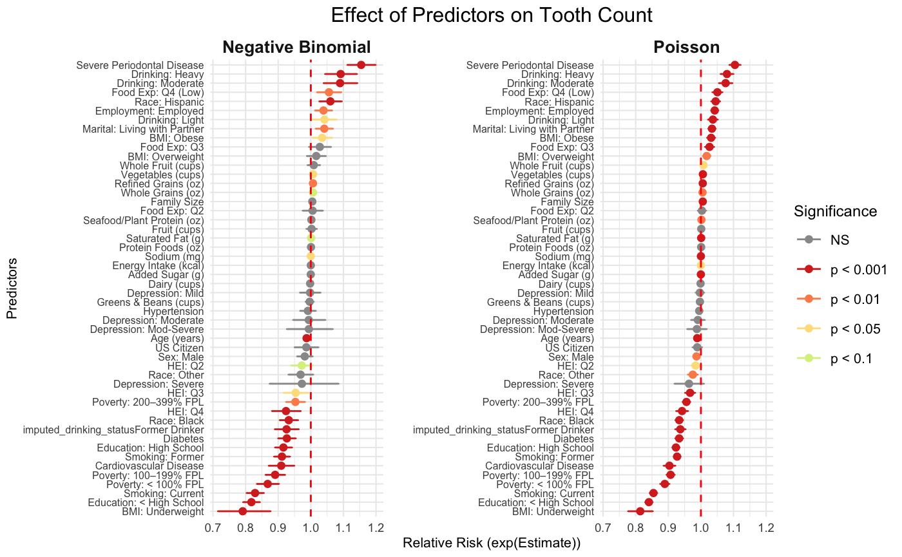
Poisson Model & Negative Binomial Model Results

Slide 81
Modeling Tooth Count: Data Integrity, Diagnostic Validity, and Ethical Modeling
Why Use Tooth Count ≥ 10?
Clinical Validity: Diagnosing periodontitis (via CAL/PD) requires ≥6–10 teeth; fewer teeth may result in unreliable classification.
Epidemiological Standards: NHANES and dental literature often define "partial dentition" as ≥10 teeth.
Bias Reduction: Participants with few teeth tend to be classified as “None/Mild” due to lack of data — not true absence of disease.
Model Robustness: Avoids paradoxes where “Severe PD” appears to have more teeth.
Why NOT use Imputed Severe PD as a predictor?
Imputed Severe PD is derived from imputed CAL/PD — which were predicted using Tooth Count.
Using it to predict Tooth Count causes information leakage and circular logic.
Consequences:
Inflated statistical significance
Biased coefficients
Violates modeling principles: A → B → A is not valid inference
Rationale | Explanation
Clinical Threshold | "Partial dentition" often defined as ≥10 teeth in periodontal research.
Epidemiological Standard | NHANES and other studies use ≥10 teeth as a proxy for functional dentition.
Statistical Validity | Ensures enough teeth are available to reliably detect disease patterns.
Bias Reduction | Reduces misclassification of "None/Mild" due to too few teeth to diagnose.
Sample-Quality Trade-off | ≥10 preserves enough sample size while improving diagnostic accuracy.

Slide 82
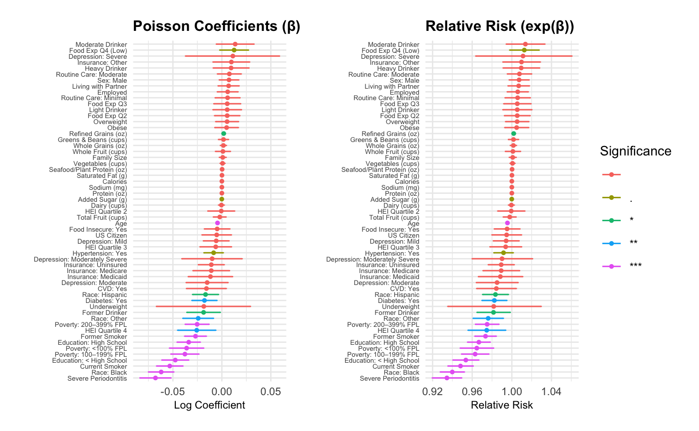
Poisson Model Result
Criteria: Tooth Count ≥ 10
Residual deviance: 5450.218
Residual degrees of freedom: 8400
Overdispersion ratio: 0.6488354

Slide 83

Poisson Model Result
Criteria: Tooth Count ≥ 6
Residual deviance: 9984.679
Residual degrees of freedom: 8802
Overdispersion ratio: 1.134365

Slide 84
Model Validation for Poisson Regression
Validation Item | Description | Model Validation Result
Overdispersion Ratio | Check whether the variance substantially exceeds the mean. If the overdispersion ratio is > 1.5, consider switching to a Negative Binomial regression model. | Overdispersion: 0.65 Interpretation: Underdispersion; Poisson model remains valid — no need for Negative Binomial
Residual Analysis | Examine the distribution of residuals (e.g., deviance residuals) to assess whether they appear randomly scattered, indicating a good model fit. | See Graph
Cross-Validation RMSE | Use K-fold cross-validation (e.g., with the boot package) to estimate the model's predictive performance, typically measured by Root Mean Square Error (RMSE). | RMSE (CV): 4.047 Interpretation: Moderate predictive error (±4 teeth); reasonable for a 10–28 range
Predicted vs Actual Plot | Plot predicted values against observed counts to visually assess model fit. Ideally, points should align closely to the 45-degree line. | See Graph
Overall Fit Quality: Acceptable, Could be improved with interaction terms or nonlinear effects
Notes:
RMSD, MAE

Slide 85


Model Validation for Poisson Regression
Notes:
1. Deviance Residuals vs Fitted Values (Left Plot)
Purpose: Checks model assumptions (especially linearity and variance).
Interpretation:
The red LOESS curve is curved, not flat → suggests nonlinear relationships or misspecification.
Fan shape (residual spread increases slightly across fitted values) → possible heteroscedasticity.
The “stripes” reflect the discrete nature of count data — expected in Poisson, but may suggest overdispersion or the need for a more flexible model (e.g., Negative Binomial).
2. Predicted vs Observed Tooth Count (Right Plot)
Purpose: Evaluates predictive performance.
Interpretation:
Points mostly follow the red trend line, but many fall below the 45° dashed line, showing the model underestimates tooth count for individuals with higher actual values.
This bias again suggests a potential lack of model flexibility (e.g., missing interactions, nonlinearities).

Slide 86


Comparison of Poisson vs ML Models
Random Forest CV RMSE: 3.727
XGBoost 5-Fold CV RMSE: 3.113

Slide 87
Model Validation for Poisson Regression
Aspect | Poisson Model | Random Forest | XGBoost
RMSE | ~4.05 | 3.73 | 3.11
Top Predictor | Age | Age | Age
Periodontitis | Statistically significant but mid-level | Mid-level importance | Top 2
Diet-related | Several (e.g., sugar, veg) significant | Highly important | Important but ranked lower
Model nature | Parametric, interpretable | Nonparametric, flexible | Ensemble, nonlinear, highly optimized
XGBoost outperformed Poisson in prediction accuracy (RMSE: 3.11 vs 4.05)
Age consistently ranked as the top predictor across all models
Severe Periodontitis emerged as the #2 predictor in XGBoost but was only mid-level in Poisson
Dietary factors (added sugar, saturated fat, sodium) were important in all models but more prominent in Random Forest
Machine learning models detect nonlinear patterns and variable interactions not captured by Poisson regression
Notes:
we also perform the Generalized Additive Model (GAM) , which extends a Generalized Linear Model (GLM)—like Poisson regression—by allowing non-linear relationships between the predictors and the outcome, using smooth functions.
In a GAM Poisson model, some or all linear terms βjxij\beta_j x_{ij}βj​xij​ are replaced by smooth functions fj(xij)f_j(x_{ij})fj​(xij​):
The log link is still used (as in Poisson GLM).
Each fj(⋅)f_j(\cdot)fj​(⋅) is typically a spline function estimated from the data (e.g., cubic splines, thin-plate splines).
This allows capturing non-linear effects of predictors.
Use a Poisson GAM when:
The outcome is count data (non-negative integers).
You suspect non-linear effects of continuous variables (e.g., age, income, time).
You want flexibility but still retain interpretability (through visualization of smooths).

Slide 88
Direct effects on health
(mediated through intermediate outcomes)
DOC-M Model

Slide 89


T2D Progression Model

Slide 90


CVD Progression Model

Slide 91


Arthritis Progression Model

Slide 92


Cancer Progression Model

Slide 93


High Cholesterol Progression Model
AUC < 0.7, the progression of high cholesterol cannot be captured by this model

Slide 94


Hypertension Progression Model

Slide 95


Asthma Progression Model
AUC < 0.7, the progression of asthma cannot be captured by this model

Slide 96


Gout Progression Model

Slide 97

BMI Progression Model

Slide 98
Discussion

Slide 99
Limitations of NHANES data on Oral Health MSM
Data Quality and Representativeness Issues
Sampling and Nonresponse Bias:
Declining response rates (~17–20%) disproportionately affect marginalized groups (low-income, minorities), leading to underrepresented severe oral health conditions.
Exclusion of institutionalized populations (e.g., nursing homes, prisons), with notably high edentulism rates (~40–60%), limits generalizability.
Variable Granularity and Definitions:
Periodontal data limited to those who are over 30 yrs old.
Behavioral indicators overly generalized (e.g., flossing frequency), obscuring critical behavioral patterns.
Practical and Analytical Challenges
Data Timeliness:
Periodontal disease variables (OHXPER) discontinued after the 2013–2014 cycle, limiting analyses of recent trends and interventions.
Models unable to incorporate recent behavioral and clinical variables (e.g., oral health behaviors) since the latest periodontal disease data is from the 2013–2014 cycle, limiting analysis of current trends and interventions.
Integration and Methodological Complexity
Clinical definition mismatches and different tooth-numbering systems complicate data integration with external EHR and clinical sources.
Complex survey design requiring specialized statistical techniques often inadequately handled, introducing analytical biases.

Slide 100
Next Steps
Refine the Poisson Regression Model
Introduce interaction terms to capture effect modification (e.g., CVD × HEI index diabetes × 13 HEI components).
Evaluate model fit and predictive performance using AIC/BIC and residual analysis.
Explore subgroup-specific effects across socioeconomic or clinical strata.
Complete Behavior-Responsive Risk Modeling
Extend the model to dynamically integrate 13 Healthy Eating Index components
Assess bidirectional feedback: How periodontal disease and tooth loss affect individual food intake
Integrate Oral Health Model with DOCM Framework

Slide 101
Q&A

